Slide 1
Interventions for dissociated vertical deviation Sarah R Hatt, Xue Wang, Jonathan M Holmes Issue 11, 2015
A presentation to:
Meeting name
Date

Slide 2
Table of Contents
01 | Background
02 | Types of studies
03 | Key results
04 | Tables (Risk of Bias/Forest Plots)
05 | Conclusions
06 | Acknowledgements

Slide 3
01: Background
Dissociated vertical deviation (DVD) occurs when one or both eyes drift upward
DVD is asymptomatic in some, while others suffer from double vision and eye strain
Surgery is the standard treatment, but non-surgical options are sometimes pursued
Objective:
To determine the effectiveness and safety of various surgical and non-surgical interventions in randomized controlled trials of participants with DVD.

Slide 4
02: Types of studies
Participants
Four randomized controlled trials, 248 eyes of 151 participants
Interventions
Inferior oblique anteriorization plus resection
VERSUS
Interior oblique anteriorization alone

Slide 5
03: Key results
“Only one trial reported data that allowed analysis of the primary outcome for this review, the proportion of patients with treatment success.”
“The difference between inferior oblique anteriorization plus resection versus inferior oblique anteriorization alone was uncertain when measured at least four months postoperatively”
RR 1.13, 95% CI 0.60 to 2.11, 30 participants

Slide 6
03: Key results (continued)
“All four trials reported a relatively low rate of adverse events; hypotropia, limited elevation, and need for repeat surgery were reported as adverse events associated with some of the surgical interventions.”
“No trials reported any other secondary outcome specified for our review.”

Slide 7
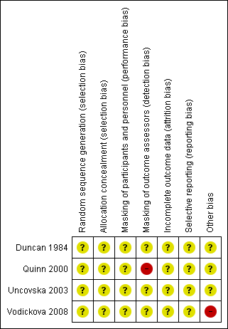
04: Tables

Slide 8
05: Conclusions
“…insufficient reporting of study methods and data led to methodological concerns that undermine the conclusions of all studies.”

Slide 9
06: Acknowledgements
Cochrane Eyes and Vision US Satellite, funded by the National Eye Institute, National Institutes of Health
Cochrane Eyes and Vision Editorial Base, funded by the UK National Health Service Research and Development Programme
Sarah R Hatt, Xue Wang, Jonathan M Holmes
Review citation
Hatt SR, Wang X, Holmes JM. Interventions for dissociated vertical deviation. Cochrane Database of Systematic Reviews 2015, Issue 11. Art. No.: CD010868. DOI: 10.1002/14651858.CD010868.pub2

