Slide 1
Endothelial keratoplasty versus penetrating keratoplasty for Fuchs endothelial dystrophy Mayank A Nanavasty, Xue Wang, Alex J Shortt Issue 2, 2014
A presentation to:
Meeting name
Date

Slide 2
Table of Contents
01 | Background
02 | Types of studies
03 | Key results
04 | Tables (Risk of Bias/Forest Plots)
05 | Conclusions
06 | Acknowledgements

Slide 3
01: Background
Fuchs endothelial dystrophy (FED) is a condition with premature degeneration of corneal endothelial cells
Penetrating keratoplasty (PKP) is the established surgical procedure for treating FED
Endothelial keratoplasty (EK) is a new procedure which may be effective
OBJECTIVE
To compare the benefits and complications of EK and PKP in replacing the diseased endothelial layer in people with FED

Slide 4
02: Types of studies
Participants
139 eyes of 136 participants, three RCTs
Interventions
Endothelial keratoplasty VERSUS penetrating keratoplasty
OR
Femtosecond laser-assisted endothelial keratoplasty VERSUS PKP

Slide 5
03: Key results
“The RCTs comparing EK with PKP did not show any significant differences between procedures with respect to best corrected visual acuity (BCVA) at two years…”
MD 0.14 logMAR, 95% CI -0.08 to 0.36, P=0.23
“Only one RCT reported on irregular astigmatism (higher-order aberration), which was less with EK than PKP…”
MD -1.20 µm; 95% CI -1.53 to -0.87; P < 0.001

Slide 6
03: Key results (continued)
“Only one RCT reported on endothelial cell counts…, primary graft failure…, and graft rejection…”
“Overall, the adverse events in the FLEK group appeared to be more frequent than in the PKP group.”

Slide 7
03: Key results (continued)

Slide 8
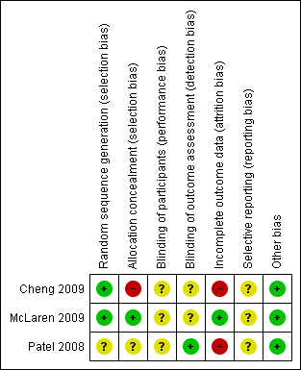
04: Tables

Slide 9
05: Conclusions
“…this review found no strong evidence from RCTs of any difference in the final visual outcome between EK and PKP for people with FED.”
“This review also found that higher order aberrations are fewer following EK but endothelial cell loss is greater following EK.”
“More RCTs are needed to compare PKP with commonly performed EK procedures such as DSEK, DSAEK and DMEK in order to determine the answers to two key questions, whether there is any difference in the final visual outcome between these techniques and whether there are differences in the rates of graft survival in the long term?”

Slide 10
06: Acknowledgements
Cochrane Eyes and Vision US Satellite, funded by the National Eye Institute, National Institutes of Health
Cochrane Eyes and Vision Editorial Base, funded by the UK National Health Service Research and Development Programme
Mayank A Nanavasty, Xue Wang, Alex J Shortt
Review citation
Nanavaty MA, Wang X, Shortt AJ. Endothelial keratoplasty versus penetrating keratoplasty for Fuchs endothelial dystrophy. Cochrane Database of Systematic Reviews 2014, Issue 2. Art. No.: CD008420. DOI: 10.1002/14651858.CD008420.pub3

