Slide 1
Difference sized incisions for phacoemulsification in age-related cataract Chongfei Jin, Xinyi Chen, Andrew Law, Xue Wang, Wen Xu, Ke Yao Issue 09, 2017
A presentation to:
Meeting name
Date

Slide 2
Table of Contents
01 | Background
02 | Types of studies
03 | Key results
04 | Tables (Risk of Bias/Forest Plots)
05 | Conclusions
06 | Acknowledgements

Slide 3
Background
A cataract is a clouding of lens in the eye.
Phacoemulsification is a cataract surgery in which one or more incisions are made to remove the cloudy lens.
Astigmatism and other adverse effects can occur after phacoemulsification.
Question:
Is the size of the incision during phacoemulsification associated with the outcomes of cataract surgery?

Slide 4
Types of studies
Participants
26 randomized controlled trials (RCTs) with a total of 2737 participants (3120 eyes)
Interventions
The larger C-MICS (2.2 mm) VERSUS standard phacoemulsification (about 3.0 mm)
OR
The smaller C-MICS (1.8 mm) VERSUS standard phacoemulsification (about 3.0 mm)
OR
The smaller C-MICS (1.8 mm) VERSUS the larger C-MICS (2.2 mm)
OR
B-MICS (<= 1.5 mm) VERSUS standard phacoemulsification (about 3.0 mm)

Slide 5
Key results
“The larger C-MICS group was favored over the standard phacoemulsification group for SIA and BCVA at three months' follow-up, but all differences were clinically small... ”
SIA: MD -0.19, 95% CI -0.30 to -0.09
“The smaller C-MICS was favored over standard phacoemulsification for SIA and BCVA, but the differences were small …”
SIA: MD -0.23, 95% CI -0.34 to -0.13

Slide 6
Key results (continued)
“We found little or no difference in SIA, BCVA, and CCT change at three months' follow-up …”
SIA: MD 0.04, 95% CI -0.09 to 0.16
“We found no difference or a clinically unimportant difference in SIA, BCVA, ECL, and CCT at three months' follow-up …”
SIA: MD -0.01, 95% CI -0.03 to 0.01

Slide 7
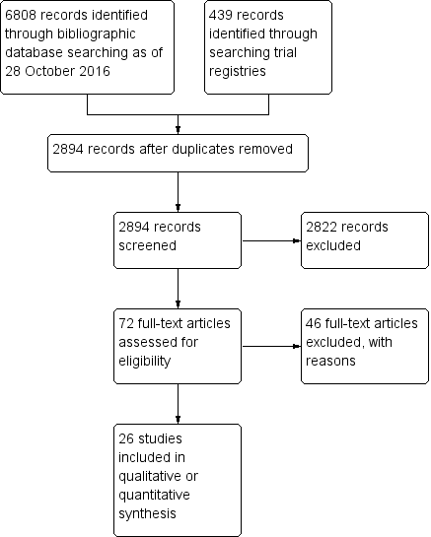
Tables Flow diagram

Slide 8
Tables Risk of Bias

Slide 9
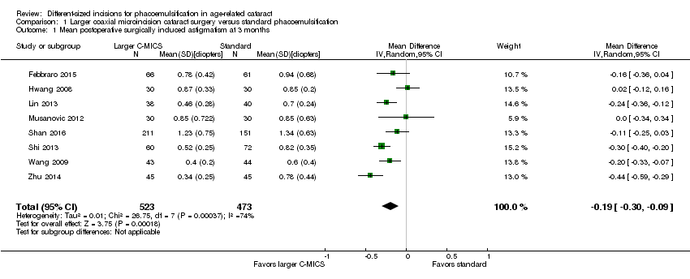
Tables Larger coaxial microincision cataract surgery vs standard phacoemulsification; Mean postoperative surgically induced astigmatism at 3 months

Slide 10
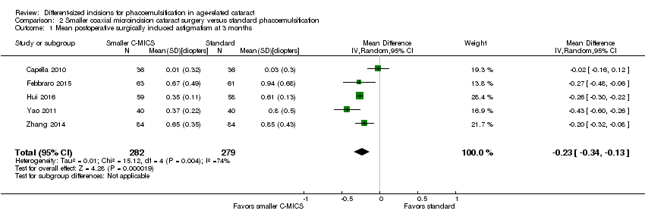
Tables Smaller coaxial microincision cataract surgery vs standard phacoemulsification; Mean postoperative surgically induced astigmatism at 3 months

Slide 11
Tables Smaller vs larger coaxial microincision cataract surgery; Mean postoperative surgically induced astigmatism at 3 months

Slide 12
Tables Biaxial microincision cataract surgery vs standard phacoemulsification; Mean postoperative surgically induced astigmatism at 3 months

Slide 13
Conclusions
“This review was limited by the very low- to moderate-certainty evidence that did not show a consistent benefit in smaller incisions with respect to surgically induced astigmatism.”
“…the choice of surgical technique should be based on the patient's medical history, patient and physician preferences, and the skill of the surgeon.”
“There is a need for better-reported randomized controlled trials and randomized controlled trials that collect and report data on adverse events when comparing different-sized incisions for age-related cataract.”

Slide 14
Acknowledgements
Cochrane Eyes and Vision US Satellite, funded by the National Eye Institute, National Institutes of Health
Cochrane Eyes and Vision Editorial Base, funded by the UK National Health Service Research and Development Programme
Systematic review conducted by Chonfei Jin, Xinyu Chen, Andrew Law, Yunhee Kang, Xue Wang, Wen Xu, Ke Yao in collaboration with methodologists at the Cochrane Eyes and Vision US Satellite
Review citation
Jin C, Chen X, Law A, Kang Y, Wang X, Xu W, Yao K. Different-sized incisions for phacoemulsification in age-related cataract. Cochrane Database of Systematic Reviews 2017, Issue 9. Art. No.: CD010510. DOI: 10.1002/14651858.CD010510.pub2.

