Slide 1

CEV and the NIHR trainee research network
Miss Tasanee Braithwaite
CEV Contact Editor
Moorfields Eye Hospital, London
On behalf of Richard Wormald, Iris Gordon and Anupa Shah

Slide 2
Overview
Cochrane and CEV
The NHS/NIHR research landscape and the JLA priorities: where does the CEV fit in?
What is a Systematic review?
What Cochrane resources are available to help you with your research?

Slide 3

The Cochrane Collaboration is a global independent network of health practitioners, researchers, patient advocates and others, responding to the challenge of making the vast amounts of evidence generated through research useful for informing healthcare decisions
The Cochrane Collaboration produce high-quality, relevant, accessible systematic reviews and other synthesised research evidence, free from commercial sponsorship, prejudices and other conflicts of interest
Internationally recognised as the benchmark for high quality information about the effectiveness of health care.

Slide 4
CEV UK Editorial Team
Co-ordinating Editor (Editor in Chief): Richard Wormald
Joint Co-ordinating Editor: Jenny Evans
Managing Editor: Anupa Shah
Information Specialist: Iris Gordon
Contact Editors (Clinicians/healthcare professionals for different subspecialties)

Slide 5



Slide 6
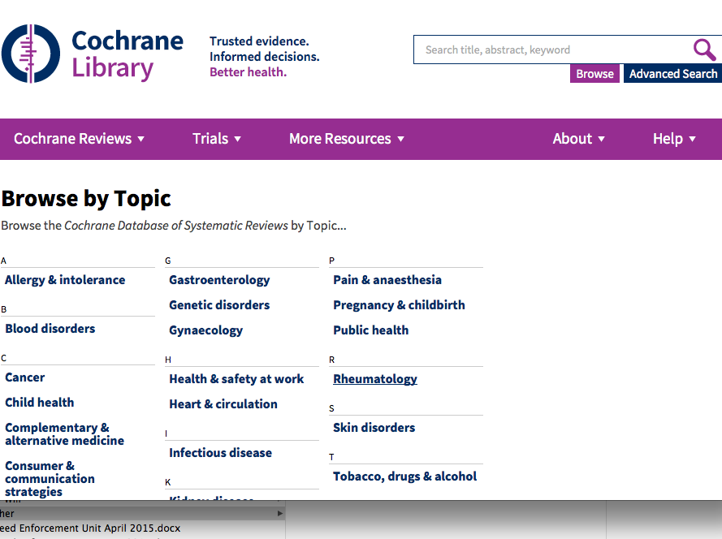

Slide 7
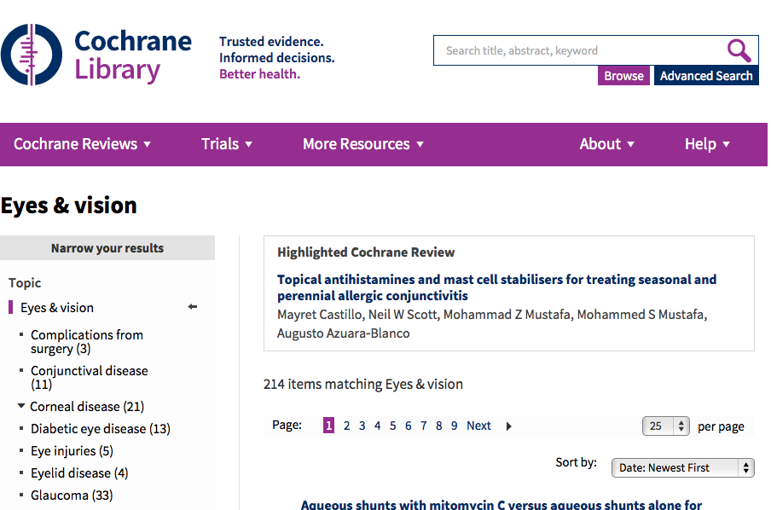

Slide 8
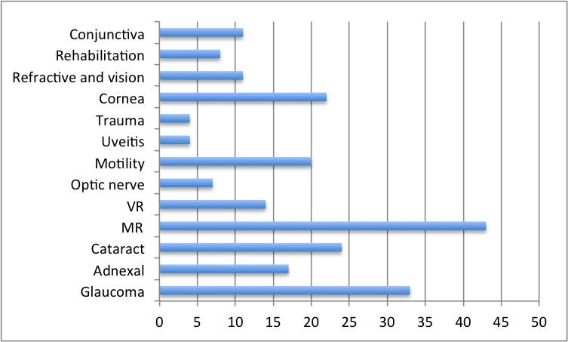
Number of CEV Reviews by subspecialty

Slide 9
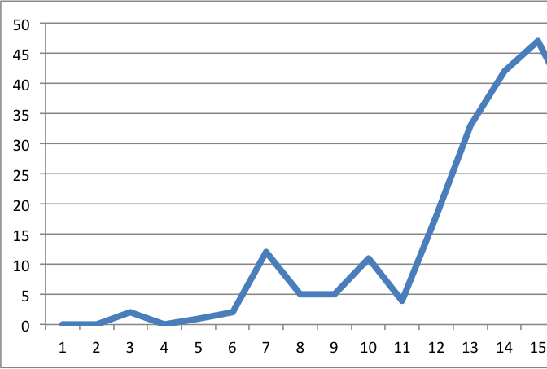
CEV Reviews published between 2000-2015

Slide 10
Priority setting in the NHS – the James Lind Alliance
Funding for research is limited
Target future research to answering the unanswered questions of greatest importance to patients, relatives, carers and eye care professionals
Sight loss and vision priority setting partnership

Slide 11
Priority setting in the NHS – the James Lind Alliance
122 research priorities
12 subjects – ARMD, cataract, childhood-onset disorders, cornea/external eye disease, glaucoma, inherited retinal disease, neuro-ophthalmology, ocular cancer, ocular inflammatory diseases, refractive error and ocular motility, retinal vascular diseases, vitreoretinal and ocular trauma
10 to 11 in each subject

Slide 12
Priority setting in the NHS – the James Lind Alliance
5 domains:
Basic science – mechanism of disease, develop novel therapies
Population-based: risk factors for disease, risk modifiers for outcomes and prognosis
Efficacy and safety of interventions
Investigations – diagnostic test accuracy, screening
Impact and enablement

Slide 13
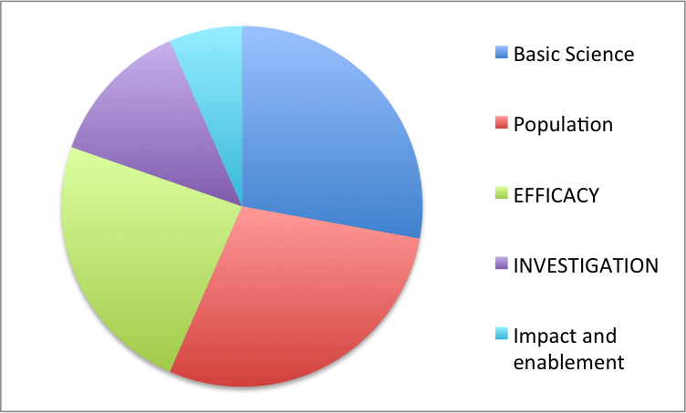
Priority setting in the NHS – the JLA

Slide 14
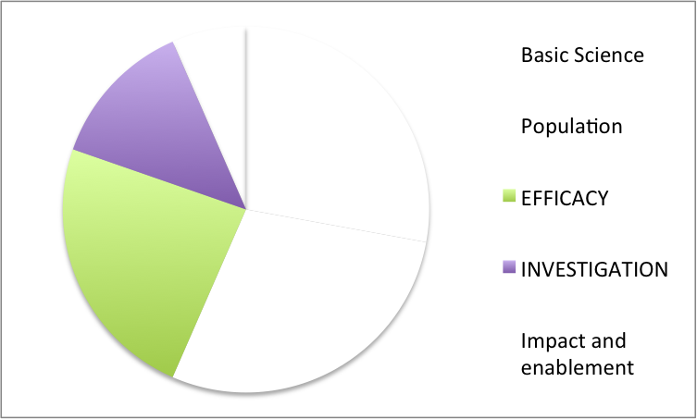
CEV and the JLA

Slide 15
What is a systematic review?
“A systematic review attempts to collate all empirical evidence that fits pre-specified eligibility criteria to answer a specific research question. It uses explicit, systematic methods that are selected with a view to minimizing bias, thus providing reliable findings from which conclusions can be drawn and decisions made”

Slide 16
Why do a systematic review?
We are inundated with unmanageable amounts of information - systematic reviews enable us to keep up to date with research evidence
Systematic reviews summarise the available evidence - aid clinical decision making and guideline development
Methodologically rigorous - attempt to limit issues of bias in both the included trials and the review process

Slide 17
Why do a systematic review?
Confirm or refute existence of a treatment uncertainty – issues of harms as well as benefits
Sometimes include studies with conflicting findings – heterogeneity in studies
Inform design of future research – empty reviews show gaps in evidence base, often required to secure funding for new studies

Slide 18
Limitations of systematic reviews
Usually only use randomised studies but come in for criticism for not using other types of studies
Rubbish in, rubbish out – problems with interpreting data
Cochrane Reviews are getting more complex to do and to understand… is this the right way to go?
Empty reviews and review conclusions that state we need more research - where does that leave the review author and the reader?

Slide 19
Embarking on a systematic review
Getting the question right is vital – issues of relevance and priority
Structure your question using the PICO format
Who is your audience – ensure outcome measures are relevant to clinicians, patients, policy makers and guideline developers
Get a statistician on board
Get an information specialist on board
Register your systematic review on PROSPERO - http://www.crd.york.ac.uk/PROSPERO/

Slide 20
Use the PICO format to structure your research question
Population: who - adults, communities, villages
Intervention: what - medical, surgical, educational
Comparison: with - dosage, placebo, sham
Outcome: how - measurement of effects. Primary and secondary outcomes

Slide 21
The Cochrane Systematic Review Process
title registration
protocol preparation
editorial and peer review of the protocol
publication of the protocol
systematic review preparation
editorial and peer review of the systematic review
publication of the systematic review
updating the systematic review

Slide 22
Why is searching important?
Systematic reviews differ from narrative reviews in that the aim is to find existing evidence on a given topic and synthesize the results.
If studies are missed then a review may be misleading. If only studies with positive outcomes are included then the review may over estimate the effect of a treatment.
Missed studies leads to publication bias

Slide 23
Constructing a search – Boolean operators
AND – retrieves only documents that have all terms
        useful for narrowing sets
OR – retrieves documents that have any terms
        useful for synonyms
NOT – retrieves documents not in the other set
        useful for limiting searches

Slide 24
Information sources to search
General medical databases: The Cochrane Library, MEDLINE, Embase
Specialist databases: PsycINFO, AMED etc.
Ongoing clinical trials registers both commercial and government
Handsearch conference proceedings
Citation searching – ISI Web of Science: Science Citation Index Expanded & Conference Proceedings Citation Index-Science
Reference lists of published articles

Slide 25
Don’t forget to consider the Grey Literature
Literature that is not published in books or journals
Examples - Government reports, conference proceedings, dissertations
Can be difficult to find – search grey literature databases such as OpenGrey. Embase has recently started to include conference abstracts
Alternative searching methods needed: search subject-specific websites eg RNIB, Sightsavers, Fight for Sight.
Grey literature may not give you enough information for data extraction, so you will probably need to contact the authors – the response rate from these requests is very low

Slide 26
And ongoing research
Identify studies in progress or studies that have been completed and no data has been published
  Add to review and update when data become available
Contact researchers of ongoing studies
  They may be willing to provide preliminary data
Check the outcome measures in the original study protocol against subsequent published reports of the study
  If some outcome measures are missing this could be selection bias.

Slide 27
Why searching hard matters: publication bias
Studies with statistically significant results are more likely:
To be published
To be published rapidly
To be published in English language journals
To be multiple publications
To be cited by other authors

Slide 28
More on bias
Random sequence generation
Allocation concealment
Masking (blinding) of participants and outcome assessors
Incomplete outcome data i.e. loss to follow up and intention-to-treat analysis
Selective reporting

Slide 29
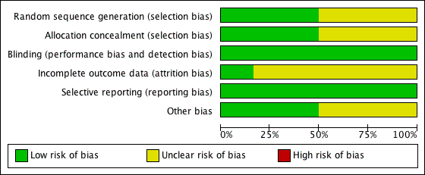
Summary table: Risk of bias

Slide 30
CEV also conduct SRs of diagnostic test accuracy
DTA reviews compare diagnostic tests ability to detect disease – reference test versus index test
DTA satellite based in Italy at the University of Florence lead by Prof Gianni Virgili
DTA handbook available at http://srdta.cochrane.org/handbook-dta-reviews

Slide 31
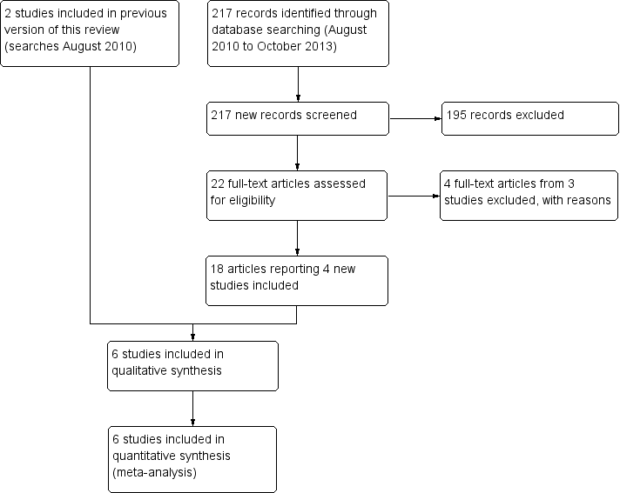
PRISMA flow diagram

Slide 32
Risk ratio
The probability of the event in the exposed versus the non-exposed group
  A relative risk of 1 means there is no difference in risk between the two groups.
  An RR of < 1 means the event is less likely to occur in the experimental group than in the control group.
  An RR of > 1 means the event is more likely to occur in the experimental group than in the control group.

Slide 33
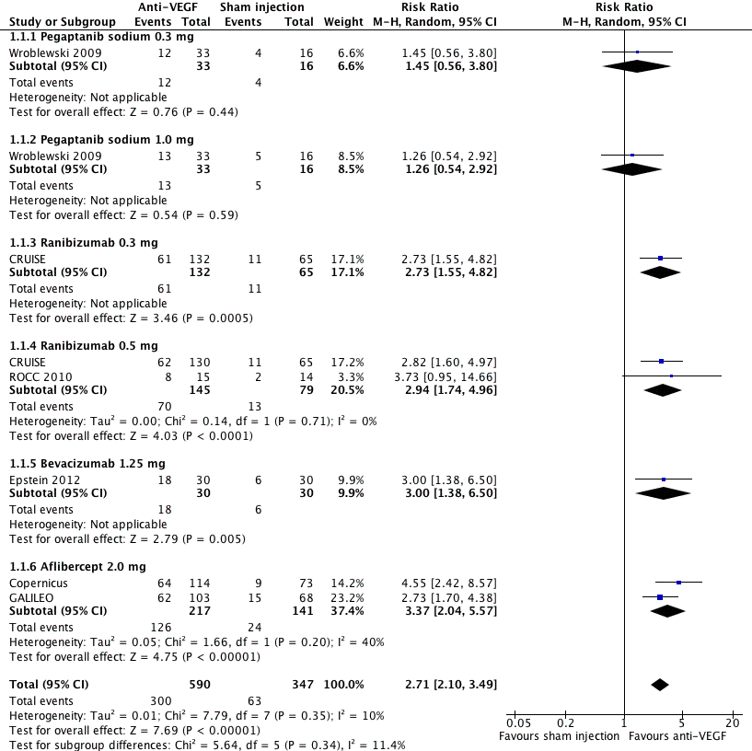

Slide 34
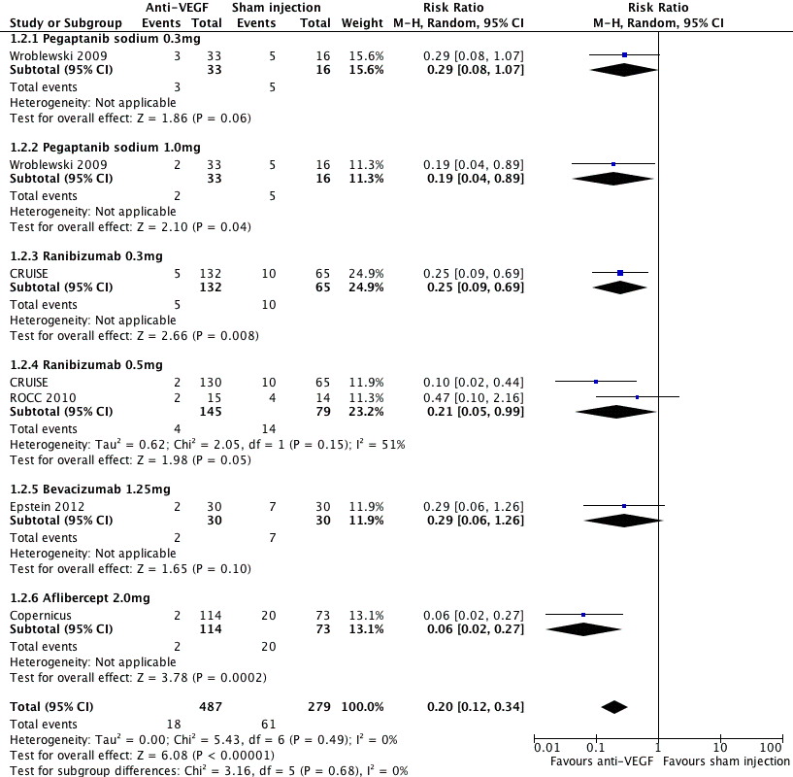

Slide 35
CEV Resources
CEV webpage links to
  Roadmap: How to complete a systematic review
  Cochrane Handbook – a comprehensive guide to conducting systematic reviews
  Methodological Expectations of Cochrane Intervention Reviews
  Cochrane Training website
  Free online course on Journal Peer Review
  Software for download
    RevMan (for preparing and maintaining Cochrane Reviews)
    GRADEpro (for creating Summary of Findings tables)
  Cochrane Library
    60 Protocols, 140 Reviews

Slide 36
CEV Training Resources for Peer Review www.eyes.cochrane.org/free-online-course-journal-peer-review
Course objectives. To understand
The available evidence regarding the effectiveness and utility of the peer review process
The purpose, process, and responsibilities in peer review from the perspective of the author, editor and peer reviewer
The different types of clinical research questions and appropriate designs for studying them
The strengths and limitations of the various study designs
Measures used to test association between exposures and outcomes
How to apply critical appraisal to manuscripts submitted for peer review
How to provide meaningful feedback to authors and editors that they can use to improve manuscript quality
Oriented to ophthalmologists, optometrists and other vision practitioners
12 lectures

Slide 37
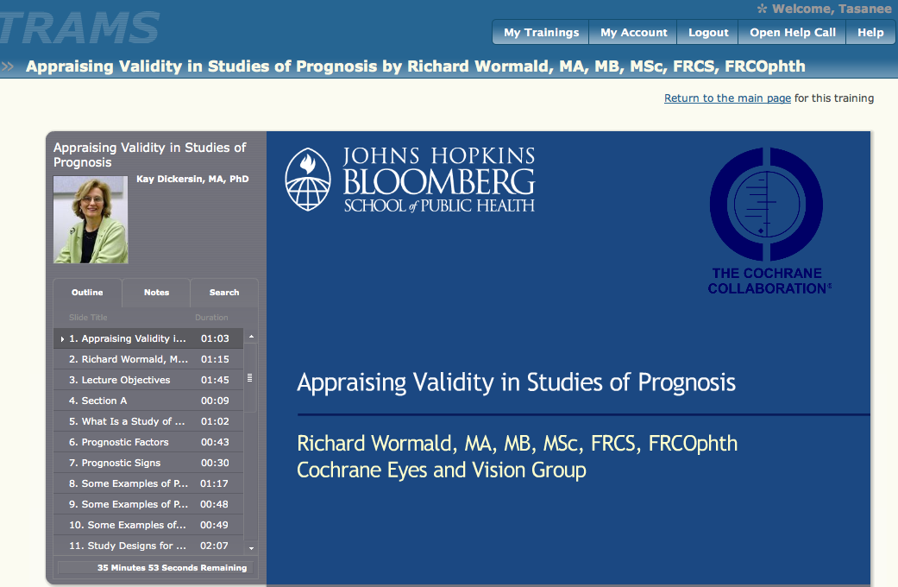

Slide 38
Cochrane Training www.training.cochrane.org
12 Online Learning Modules available to approved review authors
Introduction to systematic reviews
  Writing a Cochrane protocol
  Searching for studies
  Collecting data
  Risk of bias
  Meta-analysis
  Types of data
  Heterogeneity
  Analysing data
  Interpreting results
  Health economics
  Writing abstracts and Plain Language Summaries

Slide 39
CEV and you?
  A COCHRANE REVIEW IS A SOLID PIECE OF RESEARCH WITH A SIGNIFICANT IMPACT FACTOR
  MANY COCHRANE REVIEWS HAVE BEEN WRITTEN BY OPHTHALMOLOGISTS IN TRAINING
  IF THE QUESTION MATTERS, A COCHRANE REVIEW IS A VALUABLE STEP TO SECURE FUNDING
  ‘If something is worth doing, it is worth doing properly’

