Slide 1
Vitamin A and fish oils for retinitis pigmentosa Sobharani Rayapudi, Stephen G Schwartz, Xue Wang, Pamela Chavis Issue 12, 2013
A presentation to:
Meeting name
Date

Slide 2
Table of Contents
01 | Background
02 | Types of studies
03 | Key results
04 | Tables (Risk of Bias/Forest Plots)
05 | Conclusions
06 | Acknowledgements

Slide 3
01: Background
Retinitis pigmentosa (RP) classifies a group of eye diseases that cause degeneration of the retinal photoreceptors
Symptoms can start at any age
There is no proven therapy to treat RP
OBJECTIVE:
To synthesize evidence for the effectiveness and safety of Vitamin A and fish oils in preventing the progression of RP

Slide 4
02: Types of studies
Participants
866 participants, three RCTs
Interventions
Vitamin A alone
Fish oil alone
Vitamin A + Fish oil vs Vitamin A alone

Slide 5
03: Key results
“The primary outcome, mean change of visual field from baseline at one year, was not reported in any of the studies.”
“No toxicity or adverse events were reported in these three trials.”
“No trial reported a statistically significant benefit of vitamin supplementation on the progression of visual field loss or visual acuity loss.”

Slide 6
03: Key results (continued)
“Two of the three trials reported statistically significant differences in ERG amplitudes among some subgroups of participants, but these results have not been replicated or substantiated by findings in any of the other trials.”

Slide 7
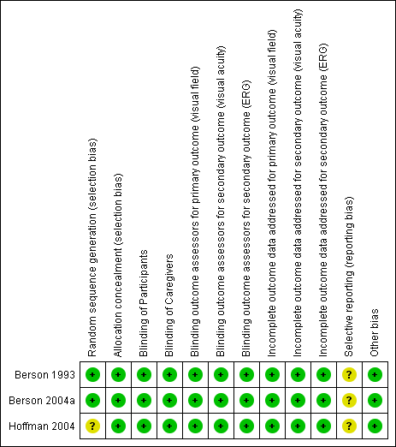
04: Tables

Slide 8
05: Conclusions
“Based on the results of three RCTs, there is no clear evidence for benefit of treatment with vitamin A and/or DHA for people with RP, in terms of the mean change in visual field and ERG amplitudes at one year and the mean change in visual acuity at five years follow-up. ”

Slide 9


06: Acknowledgements
Cochrane Eyes and Vision US Satellite, funded by the National Eye Institute, National Institutes of Health
Cochrane Eyes and Vision Editorial Base, funded by the UK National Health Service Research and Development Programme
Sobharani Rayapudi, Stephen G Schwartz, Xue Wang, Pamela Chavis
Review citation
Rayapudi S, Schwartz SG, Wang X, Chavis P. Vitamin A and fish oils for retinitis pigmentosa. Cochrane Database of Systematic Reviews 2013, Issue 12. Art. No.: CD008428. DOI: 10.1002/14651858.CD008428.pub2

