Slide 1
Systemic safety of bevacizumab versus ranibizumab for neovascular age-related macular degeneration Moja L, Lucenteforte E, Kwag KH, Bertele V, Campomori A, Chakravarthy U, D'Amico R, Dickersin K, Kodjikian L, Lindsley K, Loke Y, Maguire M, Martin DF, Mugelli A, Mühlbauer B, Püntmann I, Reeves B, Rogers C, Schmucker C, Subramanian ML, Virgili G Issue 9, 2014
A presentation to:
Meeting name
Date

Slide 2
Table of Contents
01 | Background
02 | Types of studies
03 | Key results
04 | Tables (Risk of Bias/Forest Plots)
05 | Conclusions
06 | Acknowledgements

Slide 3
01: Background
Neovascular age-related macular degeneration (AMD) is a leading cause of blindness
Bevacizumab and Ranibizumab inhibit vascular endothelial cell growth
Bevacizumab is a cancer drug, though it is often used to treat AMD
OBJECTIVE:
To assess the safety of intravitreal bevacizumab compared with intravitreal ranibizumab in people with neovascular AMD.

Slide 4
02: Types of studies
Participants
9 RCTs; 3665 participants
Interventions
Intravitreal bevacizumab (1.25 mg)
VERSUS
Intravitreal ranibizumab (0.5 mg)

Slide 5
03: Key results
“At the maximum follow-up (one or two years), the estimated risk ratio (RR) of death with bevacizumab compared with ranibizumab was 1.10 (95% confidence interval (CI) 0.78 to 1.57.”
“For all serious systematic adverse events (SSAEs), the estimated RR was 1.08 (95% CI 0.90 to 1.31, P value = 0.41; nine studies, 3665 participants; low quality evidence). Based on the event rates in the studies, this gives a risk of SSAEs of 22.2% with ranibizumab and with bevacizumab of 24% (95% CI 20% to 29.1%).”

Slide 6
03: Key results (continued)
“For the secondary outcomes, we could not detect any difference between bevacizumab and ranibizumab, with the exception of gastrointestinal disorders MedDRA SOC where there was a higher risk with bevacizumab”
RR 1.82, 95% CI 1.04 to 3.19, P-value 0.04

Slide 7
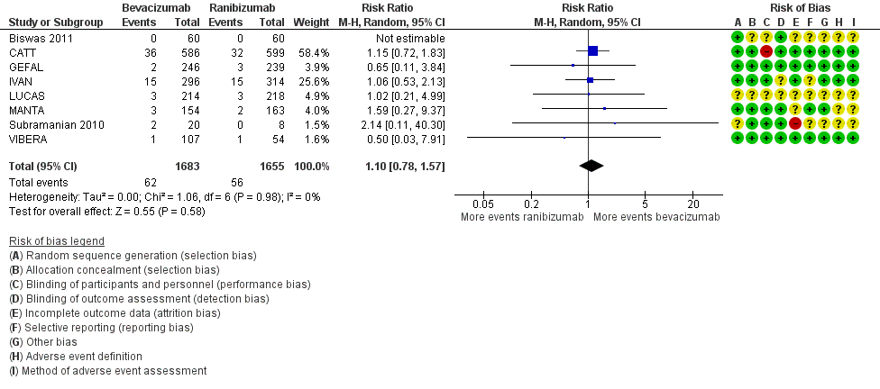
04: Tables All causes of death

Slide 8
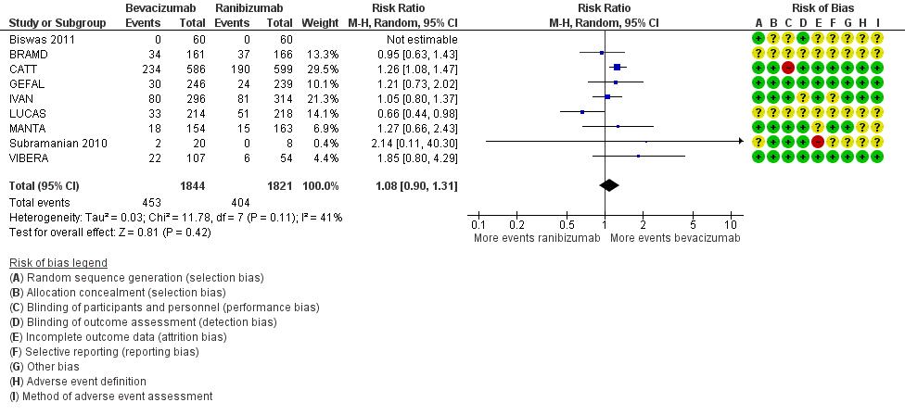
04: Tables All serious systematic adverse events

Slide 9
05: Conclusions
“This systematic review of non-industry sponsored RCTs could not determine a difference between intravitreal bevacizumab and ranibizumab for deaths, All SSAEs, or specific subsets of SSAEs in the first two years of treatment, with the exception of gastrointestinal disorders.”

Slide 10


06: Acknowledgements
Cochrane Eyes and Vision US Satellite, funded by the National Eye Institute, National Institutes of Health
Cochrane Eyes and Vision Editorial Base, funded by the UK National Health Service Research and Development Programme
Lorenzo Moja, Ersilia Lucenteforte, Koren H Kwag, Vittorio Bertele, Annalisa Campomori, Usha Chakravarthy, Roberto D'Amico, Kay Dickersin, Laurent Kodjikian, Kristina Lindsley, Yoon K Loke, Maureen Maguire, Daniel F Martin, Alessandro Mugelli, Bernd Mühlbauer, Isabel Püntmann, Barnaby C Reeves, Chris Rogers, Christine Schmucker, Manju L Subramanian, Gianni Virgili

Slide 11
06: Acknowledgements
Review Citation
Moja L, Lucenteforte E, Kwag KH, Bertele V, Campomori A, Chakravarthy U, D'Amico R, Dickersin K, Kodjikian L, Lindsley K, Loke Y, Maguire M, Martin DF, Mugelli A, Mühlbauer B, Püntmann I, Reeves B, Rogers C, Schmucker C, Subramanian ML, Virgili G. Systemic safety of bevacizumab versus ranibizumab for neovascular age-related macular degeneration. Cochrane Database of Systematic Reviews 2014, Issue 9. Art. No.: CD011230. DOI: 10.1002/14651858.CD011230.pub2

