Slide 1
Probing for congenital nasolacrimal duct obstruction Carisa Petris, Don Liu Issue 7, 2017
A presentation to:
Meeting name
Date

Slide 2
Table of Contents
01 | Background
02 | Types of studies
03 | Key results
04 | Tables (Risk of Bias/Forest Plots)
05 | Conclusions
06 | Acknowledgements

Slide 3
Background
Congenital nasolacrimal duct obstruction (NDLO) causes excessive tearing in infants
This can lead to infections
The obstruction usually resolves on its own, but probing may help resolve symptoms sooner

Slide 4
Systematic review objective
To assess the effects of probing for congenital nasolacrimal duct obstruction.

Slide 5
Types of studies
Randomized trial
P= children with congenital nasolacrimal duct obstruction aged three weeks to four years presenting with tearing and conjunctivitis
I= probing vs no probing, deferred probing, or other interventions

Slide 6
Outcomes examined
Benefits
Treatment success (absence of clinical signs and symptoms, including epiphora and mucous discharge)
Cost effectiveness
Harms
Patients requiring secondary procedures
Complications such as bleeding, injury to the nasolacrimal system or eye, or canicular stenosis

Slide 7
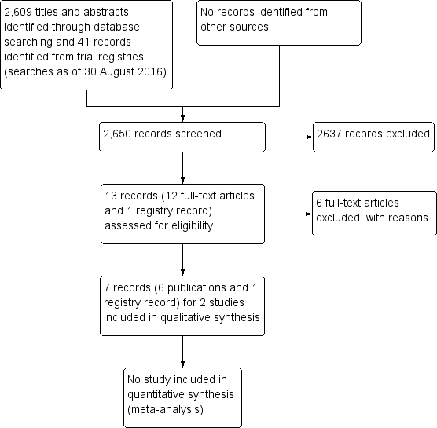
Results

Slide 8
Results
Two eligible RCTs (303 eyes of 242 participants, enrolled under the age of 12 months)

Slide 9
03: Key results (continued)
“In the other small study (26 eyes of 22 children), more eyes that received immediate probing were cured within one month after surgery compared with eyes that were randomized to deferred probing and analyzed at age 15 months (RR 2.56, 95% CI 1.16 to 5.64)…”

Slide 10
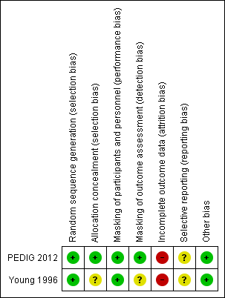
04: Tables

Slide 11
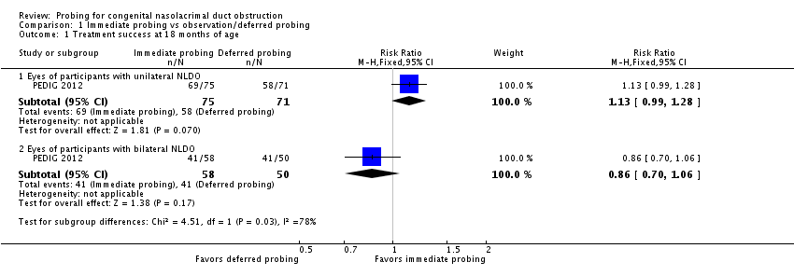
04: Tables Treatment success at 18 months of age

Slide 12
05: Conclusions
“The effects and costs of immediate versus deferred probing for NLDO are uncertain.”
“Determining whether to perform the procedure and its optimal timing will require additional studies with greater power and larger, well-run clinical trials”

Slide 13


06: Acknowledgements
Cochrane Eyes and Vision US Satellite, funded by the National Eye Institute, National Institutes of Health
Cochrane Eyes and Vision Editorial Base, funded by the UK National Health Service Research and Development Programme
Carisa Petris, Don Liu
Review citation
Petris C, Liu D. Probing for congenital nasolacrimal duct obstruction. Cochrane Database of Systematic Reviews 2017, Issue 7. Art. No.: CD011109. DOI: 10.1002/14651858.CD011109.pub2

