Slide 1
Perioperative medications for preventing temporarily increased intraocular pressure after laser trabeculoplasty Linda Zhang, Jennifer S Weizer, David C Musch Issue 2, 2017
A presentation to:
Meeting name
Date

Slide 2
Table of Contents
01 | Background
02 | Types of studies
03 | Key results
04 | Tables (Risk of Bias/Forest Plots)
05 | Conclusions
06 | Acknowledgements

Slide 3
01: Background
Intraocular Pressure (IOP) is the only known modifiable risk factor for glaucoma
Laser trabeculoplasty (LTP) reduces IOP, but can cause initial spikes in IOP elevation
Perioperative glaucoma medications may help prevent increased IOP following LTP
How effective is perioperative medication in preventing temporarily increased IOP following LTP in patients with open-angle glaucoma?

Slide 4
02: Types of studies
Participants
22 randomized controlled trials, 2112 participants with open-angle glaucoma undergoing laser trabeculoplasty
Interventions
Perioperative antiglaucoma medication versus none/placebo
One perioperative medication versus another
The same medication administered before versus after LTP

Slide 5
03: Key results
“the medication group had a lower risk of IOP increase of 10 mmHg or greater within two hours compared with the no medication/placebo group (risk ratio (RR) 0.05, 95% confidence interval (CI) 0.01 to 0.20)”
“In our comparison of brimonidine versus apraclonidine, neither medication resulted in a lower risk of increased IOP of 5 mmHg or greater two hours of surgery”

Slide 6
03: Key results (continued)
“In our comparison of apraclonidine versus pilocarpine, we had insufficient data to perform meta-analyses to estimate effects on either of the primary outcomes”
“In the comparison of medication given before LTP versus the same medication given after LTP, we had insufficient data for meta-analysis of IOP increase within two hours.”

Slide 7
04: Tables IOP increase of > mmHg 2-24 hours after LTP

Slide 8
04: Tables IOP increase of > 5 mmHg 2-24 hours after LTP

Slide 9
04: Tables IOP increase of > 5 mmHg 2-24 hours after LTP

Slide 10
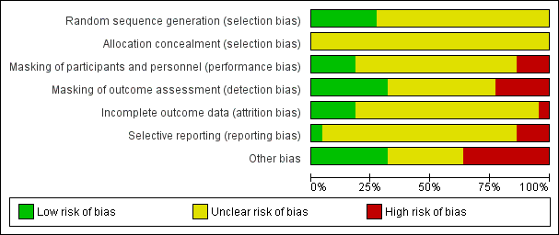
04: Tables

Slide 11
05: Conclusions
“Perioperative medications are superior to no medication or placebo to prevent intraocular pressure (IOP) spikes during the first two hours and up to 24 hours after laser trabeculoplasty (LTP).”
“Future research on this topic could be with participants who have been using these antiglaucoma medications for daily treatment of glaucoma before having LTP to see whether there is a difference in their response to the medication given perioperatively.”

Slide 12
06: Acknowledgements
Cochrane Eyes and Vision US Satellite, funded by the National Eye Institute, National Institutes of Health
Cochrane Eyes and Vision Editorial Base, funded by the UK National Health Service Research and Development Programme
Christopher J Brady, Andrea C Villanti, H Andrew Law, Ehsan Rahminy, Rahul Reddy, Pamela C Sieving, Sunir J Garg, Johnny Tang
Review citation
Brady CJ, Villanti AC, Law HA, Rahimy E, Reddy R, Sieving PC, Garg SJ, Tang J. Corticosteroid implants for chronic non-infectious uveitis. Cochrane Database of Systematic Reviews 2016, Issue 2. Art. No.: CD010469. DOI: 10.1002/14651858.CD010469.pub2.

