Slide 1
Over the counter (OTC) artificial tear drops for dry eye syndrome
Andrew Pucker, Sueko Ng, Jason Nichols
Issue 2, 2016
A presentation to:
Meeting name
  Date

Slide 2
Table of Contents
01 | Background
02 | Types of studies
03 | Key results
04 | Tables (Risk of Bias/Forest Plots)
05 | Conclusions
06 | Acknowledgements

Slide 3
Background
Over the counter eye drops are the typical first treatment for dry eye syndrome
Little is known about their efficacy
Objective:
  “To evaluate the effectiveness and toxicity of OTC artificial tear applications in the treatment of dry eye syndrome compared with another class of OTC artificial tears, no treatment, or placebo.”

Slide 4
Types of studies
  Participants
  43 randomized controlled trials, 3497 participants
  Interventions
  OTC artificial tears VERSUS another class of OTC artificial tears / placebo (e.g. saline or vehicle) / no treatment

Slide 5
Key results
“At days 21 or 28 and day 56, the difference in symptom scores when comparing 0.3% carbomer ophthalmic gel with placebo was about one point”
At days 21 or 28: MD -0.38, 95% CI -0.99 to 0.22
At day 56: MD -0.56, 95% CI -1.18 to 0.07
“Summary estimates showed that there was no significant difference in mean change in Schirmer's test values between the two treatment groups at weeks three or four”
MD -0.55, 95% CI -1.94 to 0.83; 70 participants

Slide 6
Key results (continued)
“Three trials compared 0.5% carboxymethylcellulose (CMC) with sodium hyaluronate-based eye drops for treating dry eye… meta-analysis found uncertainty in the between-group difference”
MD 0.93, 95% CI -1.39 to 3.25; 131 participants

Slide 7
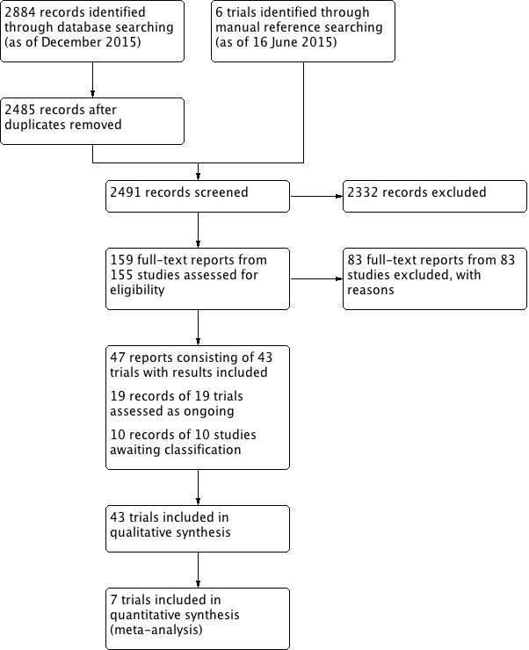
Tables
Flow diagram

Slide 8
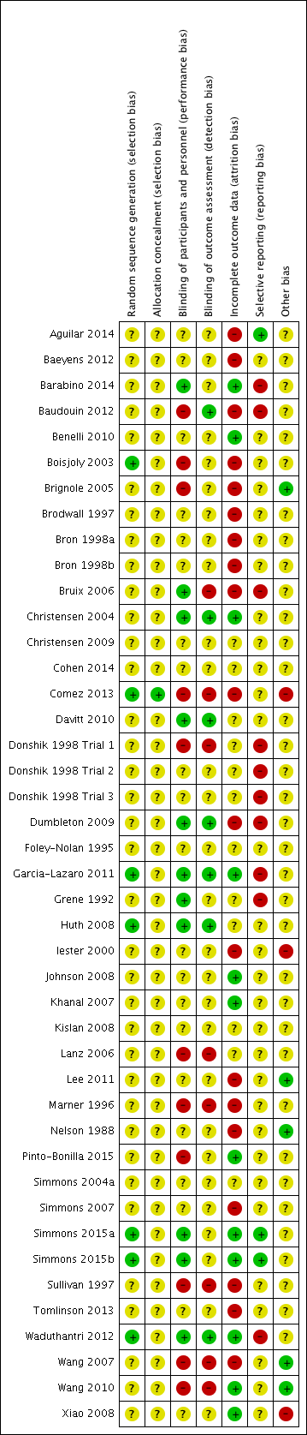
Tables
Risk of Bias

Slide 9
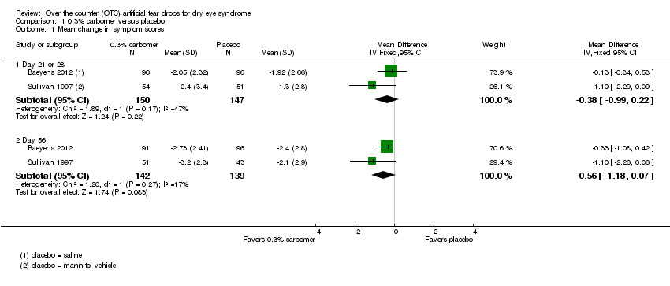
Tables
0.3% carbomer versus placebo; mean change in patient-reported symptom scores of dry eye

Slide 10
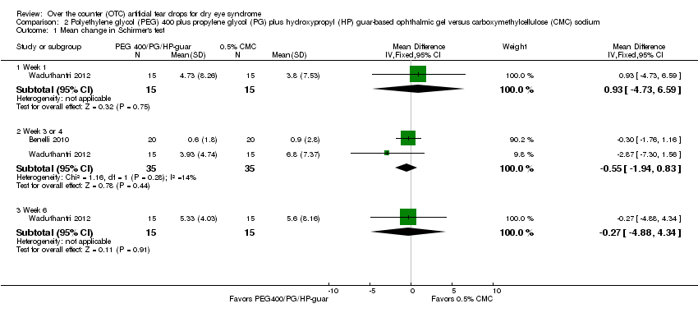
Tables
Polyethylene glycol (PEG) 400 + propylene glycol (PG) + hydroxypropyl (HP) guar-based ophthalmic gel vs carboxymethylcellulose (CMC) sodium; mean change in Schirmer's test

Slide 11
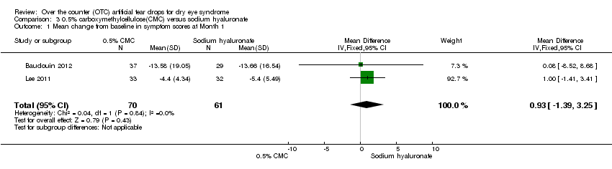
Tables
0.5% carboxymethylcellulose(CMC) versus sodium hyaluronate; mean change from baseline in symptom scores at Month 1

Slide 12
Conclusions
“This review indicates uncertainty in the comparative effectiveness of the products we evaluated for treating dry eye. In general, the literature currently indicates that most over-the-counter (OTC) artificial tears may produce similar symptomatic relief.”
“Nevertheless, the literature does not currently offer a strong conclusion on which artificial tears to use, because there are many contradictory reports and because, to the best of our knowledge, there are few RCTs that have made head-to-head comparisons with the more recent tear lipid-containing artificial tears (e.g. Systane Balance) and other artificial tear formulations …”

Slide 13


Acknowledgements
Cochrane Eyes and Vision US Satellite, funded by the National Eye Institute, National Institutes of Health
Cochrane Eyes and Vision Editorial Base, funded by the UK National Health Service Research and Development Programme
Systematic review conducted by Andrew Pucker, Sueko Ng, Jason Nichols in collaboration with methodologists at the Cochrane Eyes and Vision US Satellite
Review citation
Pucker AD, Ng SM, Nichols JJ. Over the counter (OTC) artificial tear drops for dry eye syndrome. Cochrane Database of Systematic Reviews 2016, Issue 2. Art. No.: CD009729. DOI: 10.1002/14651858.CD009729.pub2

