Slide 1
Laser treatment of drusen to prevent progression to advanced age-related macular degeneration
Gianni Virgili, Manuele Michelessi, Maurizio B Parodi, Daniela Bacherini, Jennifer R Evans
Issue 10, 2015
A presentation to:
Meeting name
  Date

Slide 2
Table of Contents
01 | Background
02 | Types of studies
03 | Key results
04 | Tables (Risk of Bias/Forest Plots)
05 | Conclusions
06 | Acknowledgements

Slide 3
01: Background
Drusen are yellowish deposits under the retina
Drusen contribute to a higher risk of developing age-related macular degeneration
Laser photocoagulation of drusen can lead to drusen disappearance and may prevent visual loss
Objective:
  To examine the effectiveness and adverse effects of laser photocoagulation of drusen in AMD

Slide 4
02: Types of studies
  Participants
  11 randomized controlled trials, 3580 eyes of 2159 participants
  Interventions
  Laser treatment of drusen in AMD
  VERSUS
  No intervention or sham treatment

Slide 5
03: Key results
“Photocoagulation did not reduce the development of CNV at two years' follow-up…”
OR 1.07, 95% CI 0.79 to 1.46; 2159 participants
“…photocoagulation led to drusen reduction but was not shown to limit loss of 3 or more lines of visual acuity.”
Drusen reduction – OR 9.16, 95% CI 6.28 to 13.4
Visual Acuity – OR 0.99, 95% CI 0.81 to 1.22

Slide 6
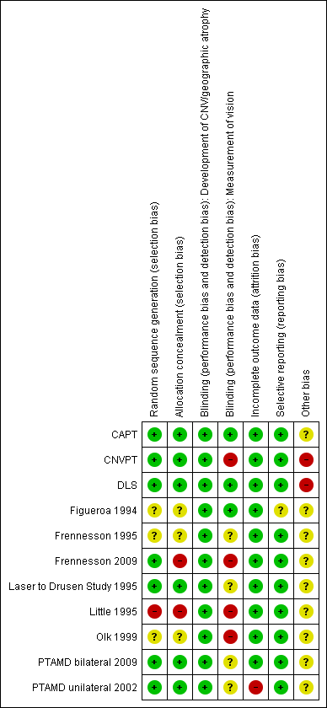
04: Tables

Slide 7
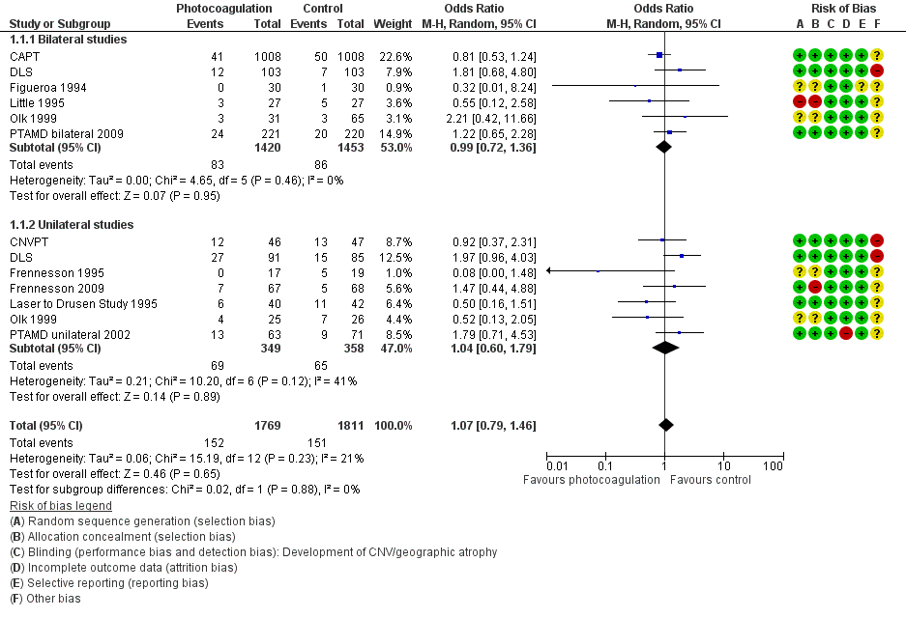
04: Tables
Development of choroidal neovascularization

Slide 8
05: Conclusions
“The trials included in this review confirm the clinical observation that laser photocoagulation of drusen leads to their disappearance. However, treatment does not result in a reduction in the risk of developing CNV, and was not shown to limit the occurrence of geographic atrophy or visual acuity loss.”

Slide 9


06: Acknowledgements
Cochrane Eyes and Vision US Satellite, funded by the National Eye Institute, National Institutes of Health
Cochrane Eyes and Vision Editorial Base, funded by the UK National Health Service Research and Development Programme
Gianni Virgili, Manuele Michelessi, Maurizio B Parodi, Daniela Bacherini, Jennifer R Evans
Review citation
Virgili G, Michelessi M, Parodi MB, Bacherini D, Evans JR. Laser treatment of drusen to prevent progression to advanced age-related macular degeneration. Cochrane Database of Systematic Reviews 2015, Issue 10. Art. No.: CD006537. DOI: 10.1002/14651858.CD006537.pub3

