Slide 1
Acupuncture for acute hordeolum Ke Chang, Andrew Law, Menghu Guo, L. Susan Wieland, Lixing Lao Issue 2, 2017
A presentation to:
Meeting name
Date

Slide 2
Table of Contents
01 | Background
02 | Types of studies
03 | Key results
04 | Tables (Risk of Bias/Forest Plots)
05 | Conclusions
06 | Acknowledgements

Slide 3
01: Background
Hordeolum is a common, acute inflammation of the eyelid, usually caused by obstructions in the sebaceous glands
Acupuncture may be an effective way to treat acute hordeolum
Objective
To investigate the effectiveness and safety of acupuncture to treat acute hordeolum compared with no treatment, sham acupuncture, or other active treatment.

Slide 4
02: Types of studies
Participants
Six randomized controlled trials, 531 participants
Interventions
Acupuncture versus conventional treatments
Acupuncture plus conventional treatment versus conventional treatment alone

Slide 5
03: Key results
“Two trials showed that resolution of acute hordeolum was more likely in the acupuncture group when compared with topical antibiotics…”
1 RCT; 32 participants; RR 3.60; 95% CI 1.34 to 9.70
“…or oral antibiotics plus warm compresses.”
1 RCT; 120 participants; RR 1.45; 95% CI 1.18 to 1.78

Slide 6
03: Key results
“One of the three RCTs did not report the resolution of acute hordeolum; however, it reported that acute hordeolum relief might be higher when acupuncture was combined with conventional treatments than with conventional treatments alone group”
60 participants; RR 1.80; 95% CI 1.00 to 3.23
“Pooled analysis of the remaining two RCTs estimated resolution of acute hordeolum was slightly higher in the combined treatment group compared with the conventional treatment alone group at 7-day follow-up”
210 participants; RR 1.12; 95% CI 1.03 to 1.23

Slide 7
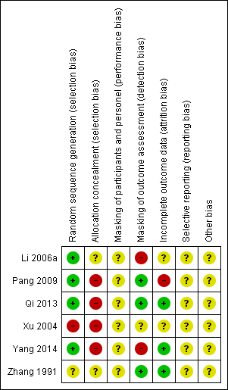
04: Tables

Slide 8
05: Conclusions
“acupuncture with or without conventional treatments may provide short-term benefits for treating acute hordeolum when compared with conventional treatments alone”
“Because no RCTs included a valid sham acupuncture control, we cannot rule out a potential expectation/placebo effect associated with acupuncture.”

Slide 9
06: Acknowledgements
Cochrane Eyes and Vision US Satellite, funded by the National Eye Institute, National Institutes of Health
Cochrane Eyes and Vision Editorial Base, funded by the UK National Health Service Research and Development Programme
Ke Chang, Andrew Law, Menghu Guo, L. Susan Wieland, Xueyong Shen, Lixing Lao
Review citation
Cheng K, Law A, Guo M, Wieland LS, Shen X, Lao L. Acupuncture for acute hordeolum. Cochrane Database of Systematic Reviews 2017, Issue 2. Art. No.: CD011075. DOI: 10.1002/14651858.CD011075.pub2

