Slide 1
Types of intraocular lenses for cataract surgery in eyes with uveitis
Theresa G Leung, Kristina Lindsley, Irene C Kuo
Issue 3, 2014
A presentation to:
Meeting name
  Date

Slide 2
Table of Contents
01 | Background
02 | Types of studies
03 | Key results
04 | Tables (Risk of Bias/Forest Plots)
05 | Conclusions
06 | Acknowledgements

Slide 3
01: Background
Cataract formation is a major complication that stems from uveitis
Following cataract surgery, intraocular lenses (IOLs) are inserted into the eye to replace the natural lens
OBJECTIVE:
  To summarize the effects of different IOLs on visual outcomes and quality of life in people with uveitis

Slide 4
02: Types of studies
  Participants
  216 participants, four RCTs
  Interventions
  Hydrophobic acrylic IOL, silicone IOL, heparin surface modification poly(methyl methacrylate) (PMMA) IOL or non-modified PMMA IOL
  HSM PMMA IOL or unmodified PMMA IOL
  Hydrophobic IOL or hydrophilic acrylic IOL

Slide 5
  03: Key results
  Hydrophobic acrylic IOL, silicone IOL, heparin surface modification poly(methyl methacrylate) (PMMA) IOL or non-modified PMMA IOL
“Proportions of participants with one or more Snellen lines of visual improvement were similar among the four treatment groups at one year' follow-up…”
“At one year' follow-up, fewer eyes randomized to hydrophobic acrylic IOLs developed posterior synechiae when compared with eyes receiving silicone IOLs (RR 0.18, 95% CI 0.04 to 0.79)”
“…the effects between these groups were less certain with respect to developing posterior capsule opacification…, corneal edema…, cystoid macular edema…, or mild IOL decentration.”

Slide 6
03: Key results (continued)
HSM PMMA IOLs versus unmodified PMMA IOLs
“Two intra-individual studies also compared HSM PMMA IOLs with unmodified PMMA IOLs at three or six months of follow-up.”
“These studies, including a combined total of 16 participants with uveitis, were insufficiently powered to detect differences in outcomes …”

Slide 7
03: Key results (continued)
Hydrophobic or hydrophilic acrylic IOL
“At three months, there were no statistical or clinical differences between hydrophobic and hydrophilic acrylic IOL types in the proportions of participants with two or more Snellen lines of visual improvement…”
RR 1.03, 95% CI 0.87 to 1.22
“There were similar rates in the development of PCO between hydrophobic or hydrophilic acrylic IOLs at six months' follow-up…”
RR 1.00, 95% CI 0.80 to 1.25

Slide 8
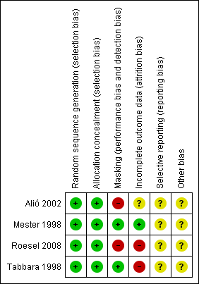
04: Tables

Slide 9
05: Conclusions
“…there is uncertainty as to which type of IOL provides the best visual and clinical outcomes in people with uveitis undergoing cataract surgery.”
“Evidence of a superior effect of hydrophobic acrylic lenses over silicone lenses, specifically for posterior synechiae outcomes comes from a single study at a high risk of performance and detection bias. ”

Slide 10


06: Acknowledgements
Cochrane Eyes and Vision US Satellite, funded by the National Eye Institute, National Institutes of Health
Cochrane Eyes and Vision Editorial Base, funded by the UK National Health Service Research and Development Programme
Theresa G Leung, Kristina Lindsley, Irene C Kuo
Review citation
Leung TG, Lindsley K, Kuo IC. Types of intraocular lenses for cataract surgery in eyes with uveitis. Cochrane Database of Systematic Reviews 2014, Issue 3. Art. No.: CD007284. DOI: 10.1002/14651858.CD007284.pub2

