Slide 1
Surgical interventions for vertical strabismus in superior oblique palsy
Melinda Chang, Anne Coleman, Victoria Tseng, Joseph Demer
Issue 11, 2017
A presentation to:
Meeting name
  Date

Slide 2
Table of Contents
01 | Background
02 | Types of studies
03 | Key results
04 | Tables (Risk of Bias/Forest Plots)
05 | Conclusions
06 | Acknowledgements

Slide 3
Background
Vertical binocular misalignment (strabismus) is a main feature of superior oblique palsy that could be treated by surgical interventions.
Vertical strabismus could lead to diplopia or anomalous head posture and then permanent contracture of the neck muscles.
Objective:
  “To assess the relative effects of surgical treatments compared with another surgical intervention, non-surgical intervention, or observation for vertical strabismus in people with superior oblique palsy.”

Slide 4
Types of studies
  Participants
  2 randomized controlled trials; 45 children and adults of both genders
  Interventions
  inferior oblique myectomy VERSUS inferior oblique recession
  AND
  inferior oblique disinsertion VERSUS anterior transposition

Slide 5
Key results
“Because the two studies included in this review compared the effects of two different pairs of surgical procedures, we were unable to combine data in a meta-analysis for any outcome targeted for this review. Furthermore, neither of the studies provided data on our primary outcome, the proportion of participants with postoperative surgical success, defined as hypertropia less than 3 PD in primary gaze. The limited data preclude any conclusion regarding optimal surgical treatment of superior oblique palsy.”

Slide 6
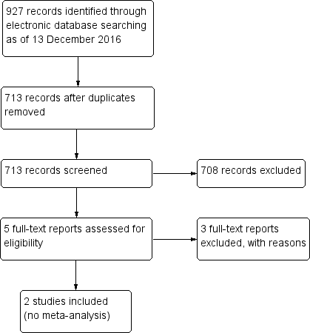
Tables
Tables
Flow
diagram

Slide 7
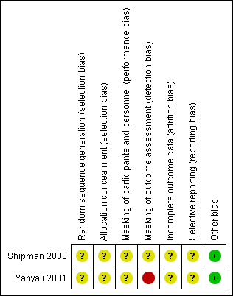
Tables
Tables
Risk of Bias

Slide 8
Conclusions
“We found no trials that evaluated our primary outcome, proportion of participants with surgical success, defined as hypertropia less than 3 prism diopters (PD) in primary gaze. Although the average reduction of hypertropia in primary gaze was found to be greater in inferior oblique myectomy than in recession (Shipman 2003), and also greater in inferior oblique anterior transposition than in disinsertion (Yanyali 2001), this outcome measure is problematic because it may depend on the magnitude of preoperative deviation. Additionally, a larger decrease in hypertropia may or may not be desirable, depending on the patient’s preoperative vertical deviation. A patient with a small preoperative hypertropia may be significantly symptomatic if overcorrected.”

Slide 9
Conclusions (continued)
“The two included trials both compared two different procedures to weaken the ipsilateral inferior oblique muscle. We did not find any trials comparing other types of surgeries for superior oblique palsy.”
“Because of the paucity of data, small number of outcomes reported, and methodological limitations causing potential biases in the two studies included in this review, we are unable to identify the optimal surgical treatment for vertical strabismus in superior oblique palsy. This finding highlights the need for larger, well-designed comparative studies to address this important question.”

Slide 10


Acknowledgements
Cochrane Eyes and Vision US Satellite, funded by the National Eye Institute, National Institutes of Health
Cochrane Eyes and Vision Editorial Base, funded by the UK National Health Service Research and Development Programme
Systematic review conducted by Melinda Chang, Anne Coleman, Victoria Tseng, Joseph Demer in collaboration with methodologists at the Cochrane Eyes and Vision US Satellite
Review citation
Chang MY, Coleman AL, Tseng VL, Demer JL. Surgical interventions for vertical strabismus in superior oblique palsy. Cochrane Database of Systematic Reviews 2017, Issue 11. Art. No.: CD012447. DOI: 10.1002/14651858.CD012447.pub2.

