Slide 1
Laser-assisted subepithelian keratectomy (LASEK) versus laser-assisted in-situ keratomileusis (LASIK) for correcting myopia
Jocelyn Kuryan, Anjum Cheema, Roy S Chuck
Issue 2, 2017
A presentation to:
Meeting name
  Date

Slide 2
Table of Contents
01 | Background
02 | Types of studies
03 | Key results
04 | Tables (Risk of Bias/Forest Plots)
05 | Conclusions
06 | Acknowledgements

Slide 3
Background
Myopia (or near-sightedness) can be treated with spectacles or refractive surgery, such as LASIK or LASEK
  LASIK – laser-assisted in situ keratomileusis
  LASEK – laser-assisted subepithelian keratectomy
Both procedures shape the corneal tissue using lasers

Slide 4
Systematic review objective
To assess the effects of LASEK versus LASIK for correcting myopia.

Slide 5
Eligible studies
Randomized trial
P=Myopia up to 12 diopters (D) and/or myopic astigmatism of severity up to 3 D, who did not have a history of prior refractive surgery
I= LASEK or LASIK in one eye vs LASIK or LASEK in the other eye
LASEK or LASIK in both eyes vs ???

Slide 6
Outcomes examined
  Benefits
    Uncorrected visual acuity (UCVA) of 20/20 at 12 months (1^{ο})
    UCVA of 20/40 or better
    Proportion of participants who lost ≥2 lines of best-corrected visual acuity (BCVA)
    Proportion of eyes within 0.5 D of target refraction
    Mean spherical equivalent of the refractive error
  Harms
    Proportion of eyes that had postoperative corneal haze
    Pain scores (intraoperative and postoperative)
    Quality of life
    Adverse events

Slide 7
PRISMA Flow Diagram
Results

Slide 8
Results
Four eligible RCTs (538 eyes of 392 participants with myopia of severity of up to 10.75 D)
No RCTs provided evidence for most of the beneficial or potentially harmful outcomes we specified
No evidence of a difference in beneficial or harmful effects between LASEK and
1 RCT: no evidence of benefit of either treatment on UCVA at 12 months
1 RCT: LASEK patients were less likely than LASIK patients to achieve a refractive error within 0.5 diopters of the target at 12 months follow-up: RR 0.69, 95% CI 0.48 to 0.99; 57 eyes
1 RCT: 10% of eyes in the LASEK group (but none of in the LASIK group) had barely detectable or trace postoperative corneal haze

Slide 9
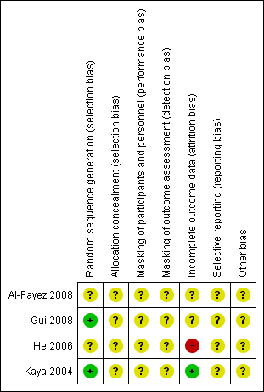
Risk of bias assessment

Slide 10
Conclusions
“Overall, from the limited data available from the studies relevant to our review, LASEK and LASIK for refractive correction of myopia appear to be similar with regards to efficacy, accuracy, and safety.”

Slide 11


Acknowledgements
Systematic review conducted by Jocelyn Kuryan, Anjum Cheema, Roy S Chuck in collaboration with methodologists at the Cochrane Eyes and Vision US Satellite
Cochrane Eyes and Vision US Satellite funded by the National Eye Institute, National Institutes of Health
Cochrane Eyes and Vision Editorial Base, funded by the UK National Health Service Research and Development Programme
Review citation:
Kuryan J, Cheema A, Chuck RS. Laser-assisted subepithelial keratectomy (LASEK) versus laser-assisted in-situ keratomileusis (LASIK) for correcting myopia. Cochrane Database of Systematic Reviews 2017, Issue 2. Art. No.: CD011080. DOI: 10.1002/14651858.CD011080.pub2

