Slide 1
Laser-assisted subepithelial keratectomy (LASEK) versus photorefractive keratectomy (PRK) for correction of myopia Si-Yuan Li, Siyan Zhan, Si-Yuan Li, Ziao-Xia Peng, Jing Hu, Hua Andrew Law, Ning-Li Wang Issue 2, 2016
A presentation to:
Meeting name
Date

Slide 2
Table of Contents
01 | Background
02 | Types of studies
03 | Key results
04 | Tables (Risk of Bias/Forest Plots)
05 | Conclusions
06 | Acknowledgements

Slide 3
01: Background
Myopia (near-sightedness) can be treated with spectacles or refractive procedures
LASEK – laser epithelial keratomileusis
PRK – photorefractive keratectomy
Objective:
“To compare LASEK versus PRK for correction of myopia by evaluating their efficacy and safety”

Slide 4
02: Types of studies
Participants
11 randomized controlled trials, 428 participants
Interventions
LASEK vs. PRK

Slide 5
03: Key results
“The proportion of eyes with uncorrected visual acuity of 20/20 or better at 12-month follow-up was comparable in LASEK and PRK groups”
RR 0.98, 95% CI 0.92 to 1.05
“At 12 months post treatment, data from two trials suggest no difference or a possibly small effect in favor of PRK over LASEK for the proportion of eyes achieving ± 0.50 D of target refraction.”
RR 0.93, 95% CI 00.84 to 1.03

Slide 6
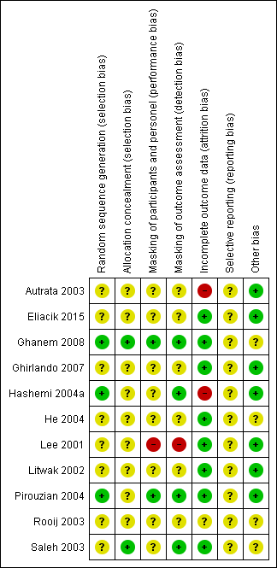
04: Tables

Slide 7
05: Conclusions
“Uncertainty surrounds differences in efficacy, accuracy, safety, and adverse effects between LASEK and PRK for eyes with low to moderate myopia. Future trials comparing LASEK versus PRK should follow reporting standards and follow correct analysis.”

Slide 8
06: Acknowledgements
Cochrane Eyes and Vision US Satellite, funded by the National Eye Institute, National Institutes of Health
Cochrane Eyes and Vision Editorial Base, funded by the UK National Health Service Research and Development Programme
Si-Yuan Li, Siyan Zhan, Si-Yuan Li, Ziao-Xia Peng, Jing Hu, Hua Andrew Law, Ning-Li Wang
Review citation
Laser-assisted subepithelial keratectomy (LASEK) versus photorefractive keratectomy (PRK) for correction of myopia. Cochrane Database of Systematic Reviews 2016, Issue 2. Art. No.: CD009799. DOI: 10.1002/14651858.CD009799.pub2

