Slide 1
Interventions for trachoma trichiasis Matthew Burton, Esmael Habtamu, Derek Ho, Emily W Gower Issue 11, 2015
A presentation to:
Meeting name
Date

Slide 2
Table of Contents
01 | Background
02 | Types of studies
03 | Key results
04 | Tables (Risk of Bias/Forest Plots)
05 | Conclusions
06 | Acknowledgements

Slide 3
01: Background
Trachoma is the leading infectious cause of blindness
Strategies to eliminate trachoma include surgery, antibiotics, and prevention measures
Objective:
To assess the interventions for trachomatous trichiasis for people living in endemic settings

Slide 4
02: Types of studies
Participants
13 studies, 8586 participants
Interventions
Five studies compared surgical interventions
Three studies examined antibiotic use following surgery
One study compared sutures
One study compared epilation to surgery
One study compared outcomes of treatments in the community
One study compared results of surgery performed by an eye doctor versus a non-specialist

Slide 5
03: Key results
“These trials suggested that the most effective surgery requires full-thickness incision of the tarsal plate and rotation of the edge of the eyelid.”
“The addition of azithromycin treatment at the time of surgery may reduce post-operative trichiasis…”
“Epilation is less effective than surgery at treating trichiasis, but has comparable results for vision and corneal change two years after intervention.”

Slide 6
03: Key results (continued)
“Surgery performed by ophthalmologists and by integrated eye care workers were both similarly effective.”

Slide 7
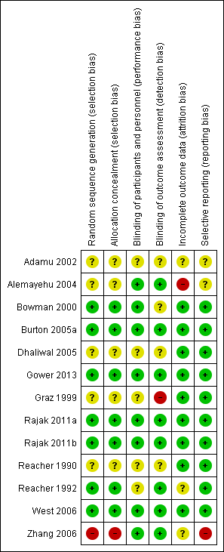
04: Tables

Slide 8
05: Conclusions
“No trials were designed to evaluate whether the interventions for trichiasis prevent blindness as an outcome…”
“Full-thickness incision of the tarsal plate and rotation of the lash-bearing lid margin was found to be the best technique and is preferably delivered in the community.”

Slide 9
06: Acknowledgements
Cochrane Eyes and Vision US Satellite, funded by the National Eye Institute, National Institutes of Health
Cochrane Eyes and Vision Editorial Base, funded by the UK National Health Service Research and Development Programme
Matthew Burton, Esmael Habtamu, Derek Ho, Emily W Gower
Review citation
Burton M, Habtamu E, Ho D, Gower EW. Interventions for trachoma trichiasis. Cochrane Database of Systematic Reviews 2015, Issue 11. Art. No.: CD004008. DOI: 10.1002/14651858.CD004008.pub3

