Slide 1
Fornix-based versus limbal-based conjunctival trabeculectomy flaps for glaucoma
Christine Al-Haddad, Marwan Abdulaal, Ahmad Al-Moujahed, Ann-Margret Ervin
Issue 11, 2015
A presentation to:
Meeting name
  Date

Slide 2
Table of Contents
01 | Background
02 | Types of studies
03 | Key results
04 | Tables (Risk of Bias/Forest Plots)
05 | Conclusions
06 | Acknowledgements

Slide 3
01: Background
Glaucoma is usually treated with IOP lowering drops or laser trabeculoplasty
In cases where those fail, trabeculectomy surgery is an option, with variations in technique
Objective:
  To assess the effectiveness of fornix versus limbal- based conjunctival flaps in trabeculectomy for adult glaucoma.

Slide 4
02: Types of studies
  Participants
  Six randomized controlled trials; 361 participants
  Interventions
  Fornix-based trabeculectomy
  VERSUS
  Limbal-based trabeculectomy

Slide 5
03: Key results
“Failure was higher among participants randomised to the limbal-based surgery: 1/50 eyes failed trabeculectomy in the fornix group compared with 3/50 in the limbal group.”
RR 0.33, 95% CI 0.04 to 3.10
“In the fornix-based surgeries, mean IOP ranged from 12.5 to 15.5 mmHg and similar results were noted in limbal-based surgeries with mean IOP ranging from 11.7 to 15.1 mmHg without significant difference.”

Slide 6
03: Key results (continued)
“…three trials reported the mean number of anti-glaucoma medications at 12 months of follow-up without significant difference in the mean number of postoperative IOP-lowering medications between the two surgical techniques.”
MD 0.02, 95% CI -0.15 to 0.19
“Because of the small numbers of events and total participants, the risk of many reported adverse events were uncertain and those that were found to be statistically significant may have been due to chance.”

Slide 7
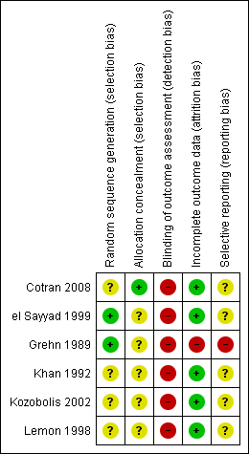
04: Tables

Slide 8
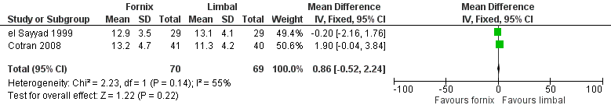
04: Tables
Mean IOP at 24 months

Slide 9
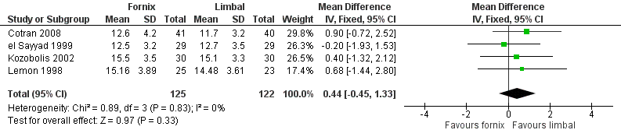
04: Tables
Mean IOP at 12 months

Slide 10
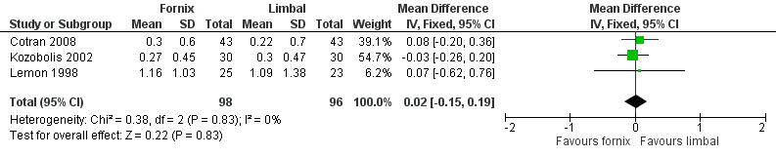
04: Tables
Mean number of anti-glaucoma medications at 12 months

Slide 11
05: Conclusions
“The main result of this review was that there was uncertainty as to the difference between fornix- and limbal-based trabeculectomy surgeries due to the small number of events and confidence intervals that cross the null.”

Slide 12


06: Acknowledgements
Cochrane Eyes and Vision US Satellite, funded by the National Eye Institute, National Institutes of Health
Cochrane Eyes and Vision Editorial Base, funded by the UK National Health Service Research and Development Programme
Christine Al-Haddad, Marwan Abdulaal, Ahmad Al-Moujahed, Ann-Margret Ervin
Review citation
Al-Haddad C, Abdulaal M, Al-Moujahed A, Ervin AM. Fornix-based versus limbal-based conjunctival trabeculectomy flaps for glaucoma. Cochrane Database of Systematic Reviews 2015, Issue 11. Art. No.: CD009380. DOI: 10.1002/14651858.CD009380.pub2

