Slide 1
Blood pressure control for diabetic retinopathy
Diana V Do, Xue Wang, Satyanarayana S Vedula, Michael Marrone, Gina Sleilati, Barbara S Hawkins, Robert N Frank
Issue 1, 2015
A presentation to:
Meeting name
  Date

Slide 2
Table of Contents
01 | Background
02 | Types of studies
03 | Key results
04 | Tables (Risk of Bias/Forest Plots)
05 | Conclusions
06 | Acknowledgements

Slide 3
Background
Diabetes has many risk factors – including high blood pressure
Diabetics often develop complications – one of which is damage to blood vessels in the back of the eye
This damage is called diabetic retinopathy
Question:
  Can diabetic retinopathy be controlled or slowed down through blood pressure control?

Slide 4
Types of studies
  Participants
  15 randomized controlled trials (RCTs); 4157 type 1 diabetic participants and 9512 type 2 diabetic participants
  Interventions
  One or more anti-hypertensive agents VERSUS Placebo
  OR
  Intense blood pressure control VERSUS less intense blood pressure control

Slide 5
Key results
“The evidence from these trials supported a benefit of more intensive blood pressure control intervention with respect to 4- to 5-year incidence of diabetic retinopathy…”
RR 0.80; 95% CI 0.71 to 0.92
“The available evidence provided less support for a benefit with respect to 4- to 5-year progression of diabetic retinopathy…”
RR 0.88; 95% CI 0.73 to 1.05

Slide 6
Key results (continued)
“The available evidence regarding progression to proliferative diabetic retinopathy or clinically significant macular edema …”
RR 0.95, 95% CI 0.83 to 1.09
or clinically significant macular edema “… or moderate to severe loss of best-corrected visual acuity did not support a benefit of intervention on blood pressure…”
RR 1.06, 95% CI 0.85 to 1.33

Slide 7
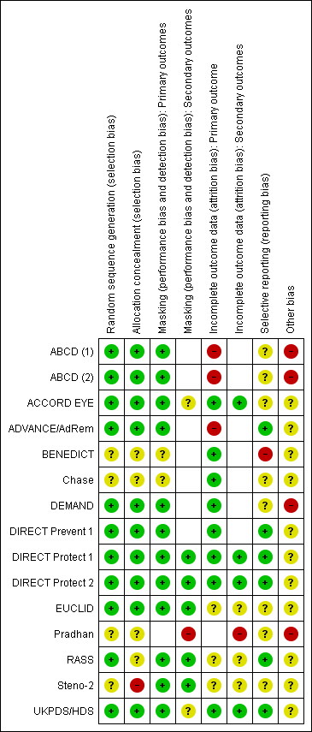
Tables
Risk of Bias

Slide 8
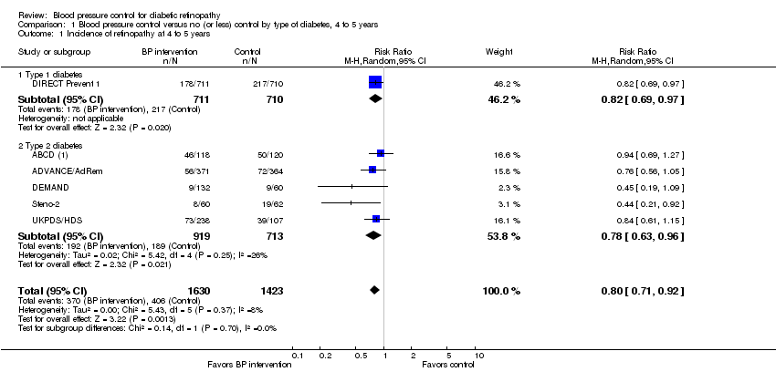
Tables
Blood pressure control vs. no (or less) control by types of diabetes; Incidence of retinopathy at 4 to 5 years

Slide 9
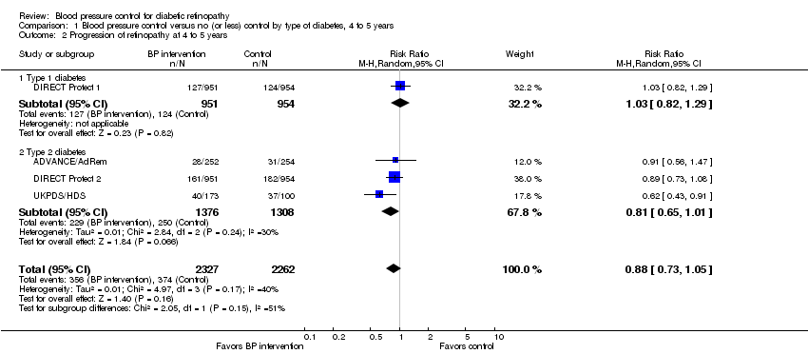
Tables
Blood pressure control vs. no (or less) control by type of diabetes; Progression of retinopathy at 4 to 5 years

Slide 10
Conclusions
“The available evidence supports a beneficial effect of intervention to reduce blood pressure with respect to preventing diabetic retinopathy for up to 4 to 5 years.”
“… the lack of evidence to support such intervention,… along with the relatively modest support for the beneficial effect on incidence, weakens the conclusion regarding an overall benefit of intervening on blood pressure solely to prevent diabetic retinopathy.”

Slide 11


Acknowledgements
Cochrane Eyes and Vision US Satellite, funded by the National Eye Institute, National Institutes of Health
Cochrane Eyes and Vision Editorial Base, funded by the UK National Health Service Research and Development Programme
Systematic review conducted by Diana V Do, Xue Wang, Satyanarayana S Vedula, Michael Marrone, Gina Sleilati, Barbara S Hawkins, Robert N Frank in collaboration with methodologists at the Cochrane Eyes and Vision US Satellite
Review citation
Do DV, Wang X, Vedula SS, Marrone M, Sleilati G, Hawkins BS, Frank RN. Blood pressure control for diabetic retinopathy. Cochrane Database of Systematic Reviews 2015, Issue 1. Art. No.: CD006127. DOI: 10.1002/14651858.CD006127.pub2

