Slide 1
Aflibercept for neovascular age-related macular degeneration Salman Sarwar, Elizabeth Clearfield, Mohamed Soliman, Mohammed Sadiq, Andrew Baldwin, Mostafa Hanout, Aniruddha Agarwal, Yasir Sepah, Diana Do, Quan Nguyen Issue 2, 2016
A presentation to:
Meeting name
Date

Slide 2
Table of Contents
01 | Background
02 | Types of studies
03 | Key results
04 | Tables (Risk of Bias/Forest Plots)
05 | Conclusions
06 | Acknowledgements

Slide 3
01: Background
Neovascular age-related macular degeneration is caused by an overgrowth of new blood vessels in the choloroid
Anti-vascular endothelial growth factor (Anti-VEGF) drugs block the signal protein which causes this overgrowth
Ranibizumab, bevacizumab, and aflibercept are commonly used
Objective
To assess and compare the effectiveness and safety of intravitreal injections of aflibercept versus ranibizumab, bevacizumab, or sham for patients with neovascular AMD

Slide 4
02: Types of studies
Participants
Two randomized controlled trials; 2457 eyes of 2457 participants
Interventions
Aflibercept
VERSUS
Ranibizumab

Slide 5
03: Key results
“Visual acuity outcomes were similar between aflibercept and ranibizumab groups at one year.”
“The proportion of participants who gained 15 or more letters of BCVA by one year of follow-up was approximately 32% for both aflibercept and ranibizumab.”
RR 0.97, 95% CI 0.85 to 1.11

Slide 6
03: Key results (continued)
“At one year, the proportion of eyes that achieved dry retina was similar between aflibercept and ranibizumab groups”
RR 1.06, 95% CI 0.98 to 1.14

Slide 7
03: Key results (continued)

Slide 8
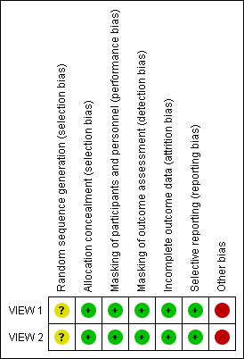
04: Tables

Slide 9
04: Tables Mean change in BCVA in ETDRS letters at 1 year

Slide 10
04: Tables Gain of > 15 letters of BCVA at 1 year

Slide 11
04: Tables Absence of fluid on optical coherence tomography at 1 year

Slide 12
04: Tables Mean change in vision-related quality-of-life scores at 1 year

Slide 13
05: Conclusions
“Results of this review document the comparative effectiveness of aflibercept versus ranibizumab for visual acuity and morphological outcomes in eyes with neovascular AMD.”

Slide 14
06: Acknowledgements
Cochrane Eyes and Vision US Satellite, funded by the National Eye Institute, National Institutes of Health
Cochrane Eyes and Vision Editorial Base, funded by the UK National Health Service Research and Development Programme
Salman Sarwar, Elizabeth Clearfield, Mohamed Soliman, Mohammed Sadiq, Andrew Baldwin, Mostafa Hanout, Aniruddha Agarwal, Yasir Sepah, Diana Do, Quan Nguyen
Review citation
Sarwar S, Clearfield E, Soliman MK, Sadiq MA, Baldwin AJ, Hanout M, Agarwal A, Sepah YJ, Do DV, Nguyen QD. Aflibercept for neovascular age-related macular degeneration. Cochrane Database of Systematic Reviews 2016, Issue 2. Art. No.: CD011346. DOI: 10.1002/14651858.CD011346.pub2

