Slide 1
Topical medication instillation techniques for glaucoma
Li Xu, Xuemei Wang, Meijing Wu
Issue 2, 2017
A presentation to:
Meeting name
  Date

Slide 2
Table of Contents
01 | Background
02 | Types of studies
03 | Key results
04 | Tables (Risk of Bias/Forest Plots)
05 | Conclusions
06 | Acknowledgements

Slide 3
01: Background
Glaucoma is the leading cause of irreversible blindness
Topical medication instillation techniques may increase ocular absorption (eyelid closure, nasolacrimal occlusion)
Objective:
  “To investigate the effectiveness of topical medication instillation techniques compared with usual care or another method of instillation of topical medication in the management of glaucoma or ocular hypertension”

Slide 4
02: Types of studies
  Participants
  Two Randomized Controlled Trials, 122 eyes of 61 participants
  Both trials used within-person design
  Interventions
  Eyelid closure vs. no eyelid closure
  Using an absorbent cloth to wipe excess fluid vs. not using the cloth

Slide 5
03: Key results
“At one to two weeks' follow-up, reduction in IOP was similar in the eyelid closure group and the no eyelid closure group”
Mean difference -0.33 mmHg, 95% confidence interval (CI) -0.8 to 1.5

Slide 6
03: Key results (continued)
“At four months' follow-up, eyelashes were shorter among eyes in the fluid removal group compared with the no fluid removal group.”
“Fewer eyes showed skin hyperpigmentation in the eyelid region towards the nose in the fluid removal group compared with the no removal group.”

Slide 7
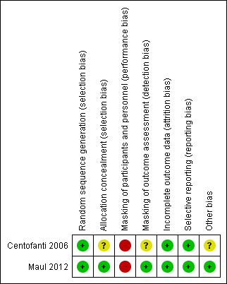
04: Tables

Slide 8
05: Conclusions
“Neither trial reported other outcomes specified for this review”
“Evidence to evaluate the effectiveness of topical medication instillation techniques for treatment of glaucoma is lacking.”

Slide 9


06: Acknowledgements
Cochrane Eyes and Vision US Satellite, funded by the National Eye Institute, National Institutes of Health
Cochrane Eyes and Vision Editorial Base, funded by the UK National Health Service Research and Development Programme
Li Xu, Xuemei Wang, Meijing Wu
Review citation
Xu L, Wang X, Wu M. Topical medication instillation techniques for glaucoma. Cochrane Database of Systematic Reviews 2017, Issue 2. Art. No.: CD010520. DOI: 10.1002/14651858.CD010520.pub2

