Slide 1
Surgical interventions for primary congenital glaucoma
Deepta Ghate, Xue Wang
Issue 1, 2015
A presentation to:
Meeting name
  Date

Slide 2
Table of Contents
01 | Background
02 | Types of studies
03 | Key results
04 | Tables (Risk of Bias/Forest Plots)
05 | Conclusions
06 | Acknowledgements

Slide 3
01: Background
Primary congenital glaucoma (PCG) appears in the first few years of a child’s life
There are several different surgical techniques used to treat PCG
OBJECTIVE:
  To compare the effectiveness and safety of different surgical techniques for PCG

Slide 4
02: Types of studies
  Participants
  6 RCTs; 102 eyes of 61 children
  Interventions
  Trabeculectomy versus goniotomy
  Trabeculectomy-trabeculotomy + Mitomycin C versus Trabeculectomy-trabeculotomy +mitomycin C + deep sclerectomy
  Combined trabeculectomy-trabeculotomy versus trabeculectomy

Slide 5
02: Types of studies
  Interventions (continued)
  One goniotomy versus two goniotomies
  Trabeculotomy versus viscocanalostomy
  Surgical goniotomy versus neodymium-YAG laser goniotomy

Slide 6
03: Key results
“No two trials compared the same pair of surgical interventions, so we did not perform any meta-analysis.”
“For IOP change and surgical success (defined by IOP achieved), none of the trials reported a difference between pairs of surgical techniques”
“Adverse events, such as choroidal detachment, shallow anterior chamber and hyphema, were reported from four trials.”

Slide 7
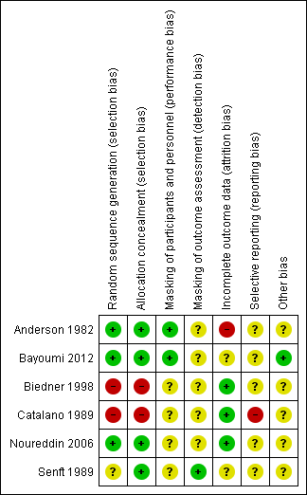
04: Tables

Slide 8
05: Conclusions
“These trials were neither designed nor reported well overall.”
“No conclusions could be drawn from the trials included in this review due to paucity of data.”

Slide 9


06: Acknowledgements
Cochrane Eyes and Vision US Satellite, funded by the National Eye Institute, National Institutes of Health
Cochrane Eyes and Vision Editorial Base, funded by the UK National Health Service Research and Development Programme
Deepta Ghate, Xue Wang
Review citation
Ghate D, Wang X. Surgical interventions for primary congenital glaucoma. Cochrane Database of Systematic Reviews 2015, Issue 1. Art. No.: CD008213. DOI: 10.1002/14651858.CD008213.pub2

