Slide 1
Spectacle correction versus no spectacles for prevention of strabismus in hyperopic children
Lisa Jones-Jordan, Xue Wang, Roberta W Scherer, Donald O Mutti
Issue 8, 2014
A presentation to:
Meeting name
  Date

Slide 2
Table of Contents
01 | Background
02 | Types of studies
03 | Key results
04 | Tables (Risk of Bias/Forest Plots)
05 | Conclusions
06 | Acknowledgements

Slide 3
01: Background
Infants are typically born hyperopic (far-sighted), then their eyes adjust
Children who remain far-sighted are prone to strabismus, or eye misalignment
Prescription glasses may prevent strabismus in children with hyperopia
OBJECTIVE
  To assess the effectiveness of prescription spectacles compared with no intervention for the prevention of strabismus in infants and children with hyperopia

Slide 4
02: Types of studies
  Participants
  855 children, 3 RCTs
  Interventions
  Spectacle intervention
  VERSUS
  No treatment

Slide 5
03: Key results
“…the effect of spectacle correction initiated prior to the age of one year in hyperopic children between three and four years of age is uncertain with respect to preventing strabismus.”
RR 0.71, 95% CI 0.44 to 1.15
“…the risk of having visual acuity worse than 20/30 at three years of age was also uncertain for children with spectacles compared with those without spectacle correction irrespective of compliance.”
RR 0.97, 95% CI 0.60 to 1.26

Slide 6
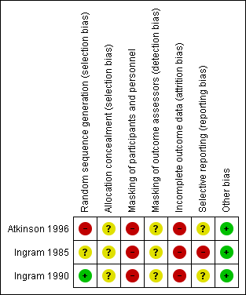
04: Tables

Slide 7
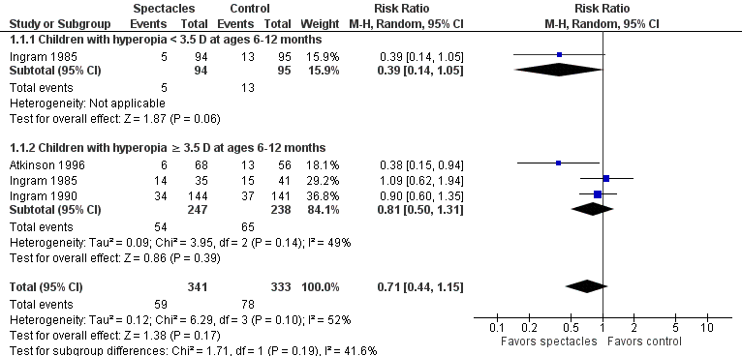
04: Tables
Incidence of strabismus at 3-4 years of age

Slide 8
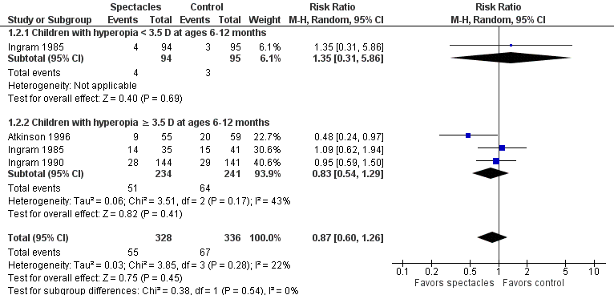
04: Tables
Visual acuity worse than 20/30 at 3-4 years of age

Slide 9
05: Conclusions
Although children who were allocated to the spectacle group were less likely to develop strabismus and less likely to have visual acuity worse than 20/30 children allocated to no spectacles, these effects may have been chance findings, or due to bias.

Slide 10


06: Acknowledgements
Cochrane Eyes and Vision US Satellite, funded by the National Eye Institute, National Institutes of Health
Cochrane Eyes and Vision Editorial Base, funded by the UK National Health Service Research and Development Programme
Lisa Jones-Jordan, Xue Wang, Roberta W Scherer, Donald O Mutti
Review citation
Jones-Jordan L, Wang X, Scherer RW, Mutti DO. Spectacle correction versus no spectacles for prevention of strabismus in hyperopic children. Cochrane Database of Systematic Reviews 2014, Issue 8. Art. No.: CD007738. DOI: 10.1002/14651858.CD007738.pub2

