Slide 1
Pneumatic retinopexy versus scleral buckle for repairing simple rhegmatogenous retinal detachments Elham Hatef, Dayse F Sena, Katherine A Fallano, Jonathan Crews, Diana V Do Issue 5, 2015
A presentation to:
Meeting name
Date

Slide 2
Table of Contents
01 | Background
02 | Types of studies
03 | Key results
04 | Tables (Risk of Bias/Forest Plots)
05 | Conclusions
06 | Acknowledgements

Slide 3
01: Background
Rhegmatogenous retinal detachment (RDD) is a break in the sensory retina, caused by traction on the retina
Pneumatic retinopexy, scleral buckle, and vitrectomy are all accepted treatments for RDD
Objective:
to assess the effectiveness and safety of pneumatic retinopexy versus scleral buckle or pneumatic retinopexy versus a combination treatment of scleral buckle and vitrectomy for people with RRD

Slide 4
02: Types of studies
Participants
218 eyes of 216 participants
Interventions
Pneumatic retinopexy
VERSUS
Scleral buckle

Slide 5
03: Key results
“Both studies showed fewer eyes achieving retinal reattachment in the pneumatic retinopexy group compared with the scleral buckle group by six-months follow-up…”
RR 0.89, 95% CI 0.77 to 1.02; 218 eyes
“Eyes in the pneumatic retinopexy group also were more likely to have had a recurrence of retinal detachment by six-months follow-up…”
RR 1.80, CI 1.00 to 3.24, 218 eyes

Slide 6
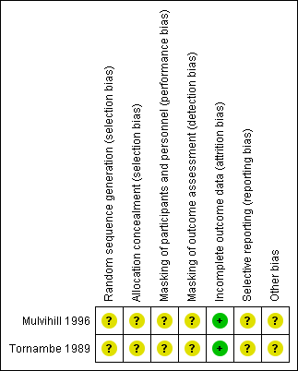
04: Tables

Slide 7
04: Tables Reattachment of the retina at 6 months follow-up

Slide 8
04: Tables Recurrence of retinal detachment through 6 months follow-up

Slide 9
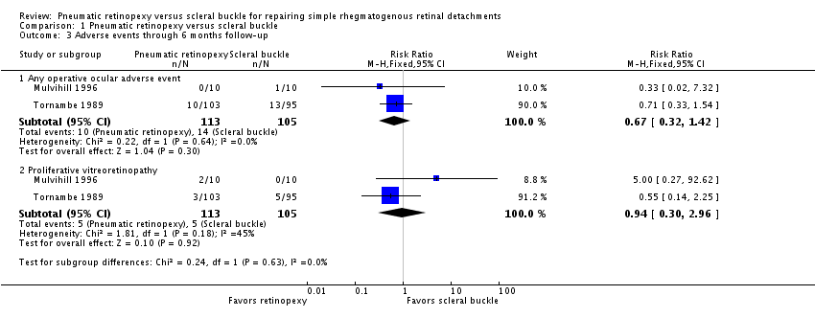
04: Tables Adverse events through 6 months follow-up

Slide 10
05: Conclusions
“… pneumatic retinopexy may result in lower rates of reattachment and higher rates of recurrence than scleral buckle for eyes with RRD, but does not rule out no difference between procedures.”

Slide 11
06: Acknowledgements
Cochrane Eyes and Vision US Satellite, funded by the National Eye Institute, National Institutes of Health
Cochrane Eyes and Vision Editorial Base, funded by the UK National Health Service Research and Development Programme
Elham Hatef, Dayse F Sena, Katherine A Fallano, Jonathan Crews, Diana V Do
Review citation
Hatef E, Sena DF, Fallano KA, Crews J, Do DV. Pneumatic retinopexy versus scleral buckle for repairing simple rhegmatogenous retinal detachments. Cochrane Database of Systematic Reviews 2015, Issue 5. Art. No.: CD008350. DOI: 10.1002/14651858.CD008350.pub2

