Slide 1
Peripheral iridotomy for pigmentary glaucoma Manuele Michelessi, Kristina Lindsley Issue 2, 2016
A presentation to:
Meeting name
Date

Slide 2
Table of Contents
01 | Background
02 | Types of studies
03 | Key results
04 | Tables (Risk of Bias/Forest Plots)
05 | Conclusions
06 | Acknowledgements

Slide 3
01: Background
Pigmentary glaucoma, in eyes with pigment dispersion syndrome, is typically treated with topical medication
Peripheral laser iridotomy may alleviate intraocular pressure, stopping or slowing pigment dispersion
Objective:
To assess the effects of peripheral laser iridotomy compared with other interventions.

Slide 4
02: Types of studies
Participants
Five randomized controlled trials, 260 eyes of 195 participants
Interventions
Yttrium-aluminium-garnet (YAG) laser iridotomy versus no laser iridotomy

Slide 5
03: Key results
“…the risk of progression of visual field damage was uncertain when comparing laser iridotomy with no iridotomy”
RR 1.00, 95% CI 0.16 to 6.25
“At three-year follow-up, one trial reported that the risk ratio for conversion to glaucoma was 2.72 (95% CI 0.76 to 9.68; 42 eyes).”

Slide 6
03: Key results (continued)
“At an average of nine months of follow-up, the mean difference in IOP between groups was 2.69 mmHg less in the laser iridotomy group than in the control group (95% CI -6.05 to 0.67; 14 eyes) ”

Slide 7
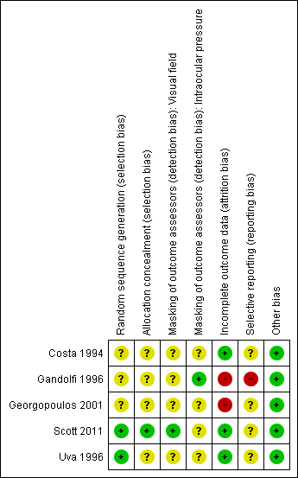
04: Tables

Slide 8
05: Conclusions
“We found insufficient evidence of high quality on the effectiveness of peripheral iridotomy for pigmentary glaucoma or pigment dispersion syndrome.”

Slide 9


06: Acknowledgements
Cochrane Eyes and Vision US Satellite, funded by the National Eye Institute, National Institutes of Health
Cochrane Eyes and Vision Editorial Base, funded by the UK National Health Service Research and Development Programme
Manuele Michelessi, Kristina Lindsley
Review citation
Michelessi M, Lindsley K. Peripheral iridotomy for pigmentary glaucoma. Cochrane Database of Systematic Reviews 2016, Issue 2. Art. No.: CD005655. DOI: 10.1002/14651858.CD005655.pub2

