Slide 1
Doxycycline plus ivermectin versus ivermectin alone for treatment of patients with onchocerciasis
Ayokunle Abegunde, Richard Ahuja, Nkem Okafor
Issue 1, 2016
A presentation to:
Meeting name
  Date

Slide 2
Table of Contents
01 | Background
02 | Types of studies
03 | Key results
04 | Tables (Risk of Bias/Forest Plots)
05 | Conclusions
06 | Acknowledgements

Slide 3
01: Background
Ochocerciasis, or “river blindness,” is a parasitic infection cased by the roundworm
Ivermectin is used to prevent and treat onchocerciasis
Doxyxycline, an antibiotic, is also used to treat onchocerciasis
Objective:
  To assess the effectiveness of doxycycline plus ivermectin versus ivermectin alone for prevention and treatment of onchocerciasis.

Slide 4
02: Types of studies
  Participants
  Three randomized controlled trials, 466 participants
  Interventions
  Docycyline plus ivermectin
  VERSUS
  Ivermectin alone

Slide 5
03: Key results
“One study investigated improvement in visual impairment at six-month follow-up; the other two studies measured microfilarial loads in skin snips to assess sustained effects of treatment at follow-up of 21 months or longer.”

Slide 6
03: Key results (continued)
“…uncertainty about the difference in the proportion of participants with improvement in visual impairment at six-month follow-up for doxycycline plus ivermectin compared with ivermectin alone.”
RR 1.06, 95% CI 0.80 to 1.39, 240 participants
More participants in the doxycycline plus ivermectin group than in the ivermectin alone group showed improvement in iridocyclitis and punctate keratitis
RR 1.24, 95% CI 0.69 to 2.22 and RR 1.43, 95% 1.02 to 2.00

Slide 7
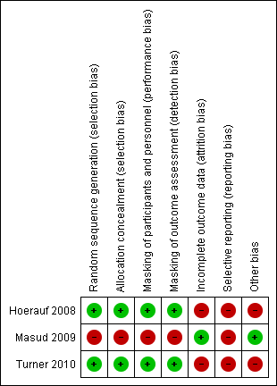
04: Tables

Slide 8
05: Conclusions
“Available evidence on the effectiveness of doxycycline plus ivermectin compared with ivermectin alone in preventing and treating onchocerciasis is unclear.”
“…a six-week course of doxycycline followed by ivermectin may result in more frequent macrofilaricidal and microfilaricidal activity and sterilization of female adult Onchocerca compared with ivermectin alone.”
“…effects on vision-related outcomes are uncertain.”

Slide 9


06: Acknowledgements
Cochrane Eyes and Vision US Satellite, funded by the National Eye Institute, National Institutes of Health
Cochrane Eyes and Vision Editorial Base, funded by the UK National Health Service Research and Development Programme
Ayokunle Abegunde, Richard Ahuja, Nkem Okafor
Review citation
Abegunde AT, Ahuja RM, Okafor NJ. Doxycycline plus ivermectin versus ivermectin alone for treatment of patients with onchocerciasis. Cochrane Database of Systematic Reviews 2016, Issue 1. Art. No.: CD011146. DOI: 10.1002/14651858.CD011146.pub2.

