Slide 1
Device-modified trabeculectomy for glaucoma
Xue Wang, Rabeea Khan, Anne Coleman
Issue 12, 2015
A presentation to:
Meeting name
  Date

Slide 2
Table of Contents
01 | Background
02 | Types of studies
03 | Key results
04 | Tables (Risk of Bias/Forest Plots)
05 | Conclusions
06 | Acknowledgements

Slide 3
01: Background
“The main treatment for glaucoma aims to reduce intraocular pressure (IOP)”
“IOP can be lowered with medications, and laser or incisional surgeries”
“Trabeculectomy is the most common incisional surgical procedure to treat glaucoma.”
Objective:
  To assess relative effectiveness of the use of different devices as adjuncts to trabeculectomy compared with standard trabeculectomy in eyes with glaucoma

Slide 4
02: Types of studies
  Participants
  33 randomized controlled trials; 1542 participants
  Interventions
  Device plus trabeculectomy (Ex-PRESS, Ologen, amniotic membrane, E-PTFE, Gelfilm)
  VERSUS
  Trabeculectomy alone

Slide 5
03: Key results
“…use of Ex-PRESS compared with trabeculectomy alone may be associated with a slightly lower IOP at one year.”
MD -1.58 mm Hg, 95% CI -2.74 to -0.42
“Cataract surgery and hyphema may be less frequent in the Ex-PRESS group than in the trabeculectomy-alone group…”
RR 0.32, 95% CI 0.14 to 0.74

Slide 6
03: Key results (continued)
“…use of Ologen compared with trabeculectomy alone is associated with slightly higher IOP at one year.”
MD 1.40 mm Hg, 95% CI -0.57 to 3.38
“…use of amniotic membrane with trabeculectomy may be associated with lower IOP at one year compared with trabeculectomy alone.”
MD -3.92 mm Hg, 95% CI -5.41 to -2.42

Slide 7
03: Key results (continued)
“…use of amniotic membrane with trabeculectomy may be associated with lower IOP at one year compared with trabeculectomy alone.”
MD -3.92, 95% CI -5.41 to -2.42; 356 eyes
“The report from the only E-PTFE study (60 eyes) showed no important differences for postoperative IOP at one year (MD -0.44 mm Hg, 95% CI -1.76 to 0.88) between the trabeculectomy + E-PTFE versus the trabeculectomy-alone groups.”

Slide 8
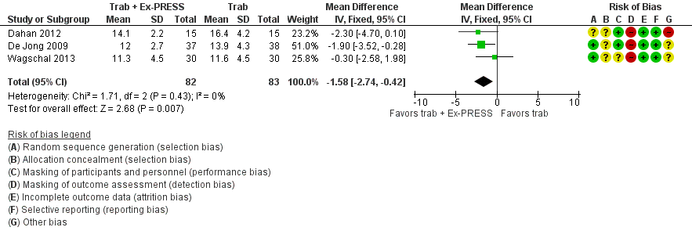
04: Tables
Postoperative IOP at one year

Slide 9
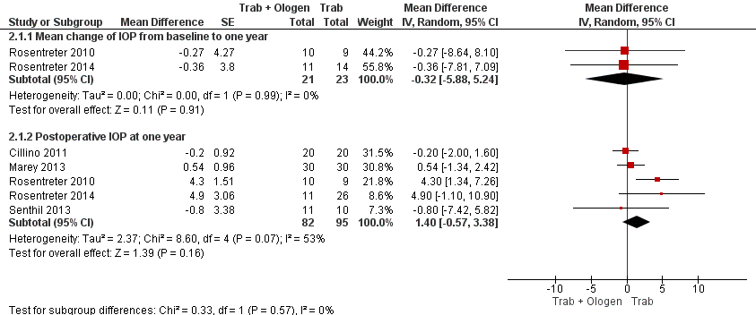
04: Tables
Postoperative IOP at one year

Slide 10
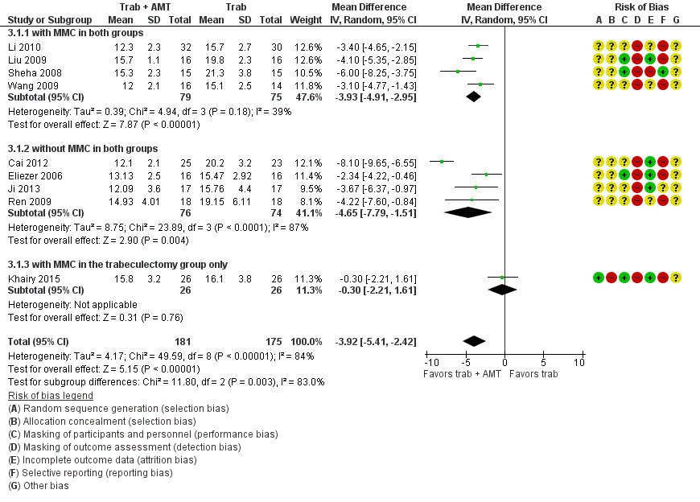
04: Tables – IOP at one year

Slide 11
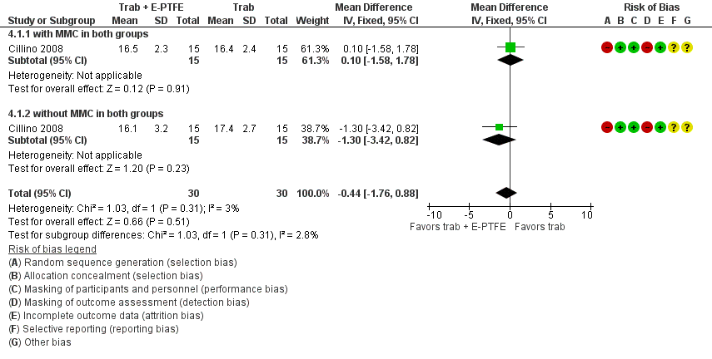
04: Tables
Post-operative IOP at one year

Slide 12
05: Conclusions
“Overall, the use of devices with standard trabeculectomy may help with greater IOP reduction at one-year follow-up than trabeculectomy alone.”
“The evidence that these devices are as safe as trabeculectomy alone is unclear.”

Slide 13


06: Acknowledgements
Cochrane Eyes and Vision US Satellite, funded by the National Eye Institute, National Institutes of Health
Cochrane Eyes and Vision Editorial Base, funded by the UK National Health Service Research and Development Programme
Xue Wang, Rabeea Khan, Anne Coleman
Review citation
Wang X, Khan R, Coleman A. Device-modified trabeculectomy for glaucoma. Cochrane Database of Systematic Reviews 2015, Issue 12. Art. No.: CD010472. DOI: 10.1002/14651858.CD010472.pub2.

