Slide 1
Corticosteroid implants for chronic non-infectious uveitis Christopher J Brady, Andrea C Villanti, H Andrew Law, Ehsan Rahminy, Rahul Reddy, Pamela C Sieving, Sunir J Garg, Johnny Tang Issue 2, 2016
A presentation to:
Meeting name
Date

Slide 2
Table of Contents
01 | Background
02 | Types of studies
03 | Key results
04 | Tables (Risk of Bias/Forest Plots)
05 | Conclusions
06 | Acknowledgements

Slide 3
01: Background
Uveitis, which many types of intraocular inflammatory diseases, is treated with corticosteroids
Steroid implants are gaining ground as an alternative treatment
Objective:
To determine the efficacy and safety of steroid implants in people with chronic non-infectious posterior uveitis, intermediate uveitis, and panuveitis

Slide 4
02: Types of studies
Participants
Two randomized controlled trials, 619 eyes of 401 participants
Interventions
Fluocinolone acetonide (FA) implants
VERSUS
Standard-of-care therapy

Slide 5
03: Key results
“a FA implant probably prevents recurrence of uveitis compared with standard-of-care therapy”
RR 0.29, 95% CI 0.14 to 0.59; 132 eyes
“increased risks of needing cataract surgery… in the implant group compared with standard-of-care therapy”
RR 2.98, 95% CI 2.33 to 3.79, 371 eyes
“increased risks of needing… surgery to lower intraocular pressure in the implant group compared with standard-of-care therapy”
RR 7.48, 95% CI 3.94 to 14.19, 599 eyes

Slide 6
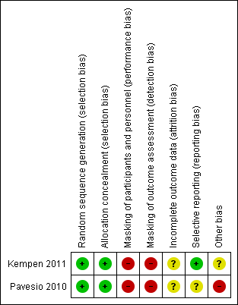
04: Tables

Slide 7
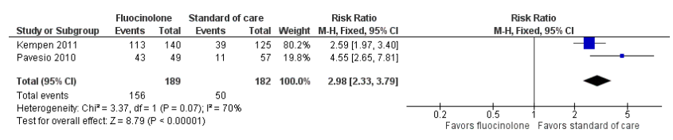
04: Tables Cataract surgery through 24 months

Slide 8
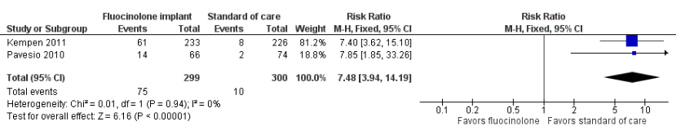
04: Tables IOP-lowering surgery performed through 24 months

Slide 9
05: Conclusions
“After considering both benefits and harms reported from two studies in which corticosteroids implants were compared with standard-of-care therapy, we are unable to conclude that the implants are superior to traditional systemic therapy for the treatment of non-infectious uveitis.”

Slide 10


06: Acknowledgements
Cochrane Eyes and Vision US Satellite, funded by the National Eye Institute, National Institutes of Health
Cochrane Eyes and Vision Editorial Base, funded by the UK National Health Service Research and Development Programme
Christopher J Brady, Andrea C Villanti, H Andrew Law, Ehsan Rahminy, Rahul Reddy, Pamela C Sieving, Sunir J Garg, Johnny Tang
Review citation
Brady CJ, Villanti AC, Law HA, Rahimy E, Reddy R, Sieving PC, Garg SJ, Tang J. Corticosteroid implants for chronic non-infectious uveitis. Cochrane Database of Systematic Reviews 2016, Issue 2. Art. No.: CD010469. DOI: 10.1002/14651858.CD010469.pub2.

