Slide 1
Conjunctival autograft for pterygium Elizabeth Clearfield, Valliammai Muthappan, Xue Wang, Irene C Kuo Issue 2, 2016
A presentation to:
Meeting name
Date

Slide 2
Table of Contents
01 | Background
02 | Types of studies
03 | Key results
04 | Tables (Risk of Bias/Forest Plots)
05 | Conclusions
06 | Acknowledgements

Slide 3
01: Background
A pterygium is a growth from the conjunctiva, which can impair eye movement and vision, as well as cause irritiation
Surgery is the only treatment
Objective:
To assess the safety and effectiveness of conjunctival autograft (with or without adjunctive therapy) compared with amniotic membrane graft (with or without adjunctive therapy) for pterygium

Slide 4
02: Types of studies
Participants
20 randomized controlled trials, 1947 eyes of 1866 participants
Interventions
Conjunctival graft
VERSUS
Amniotic membrane transplant

Slide 5
03: Key results
“The risk ratio for recurrence of pterygium using conjunctival autograft versus amniotic membrane transplant was 0.87 (95% CI 0.43 to 1.77) and 0.53 (95% CI 0.27 to 1.27) at 3 months and 6 months, respectively.”

Slide 6
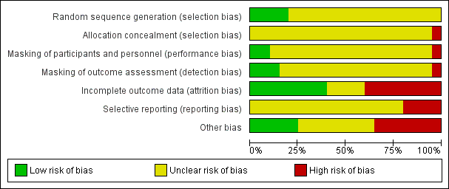
04: Tables

Slide 7
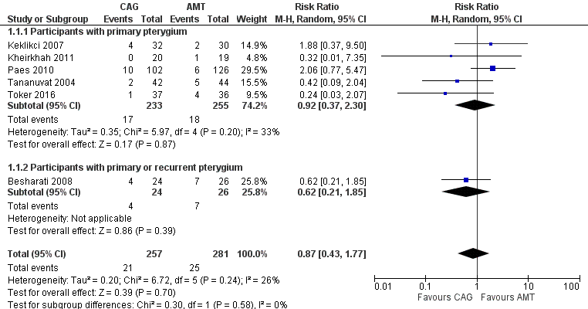
04: Tables Recurrence of pterygium at 3 months

Slide 8
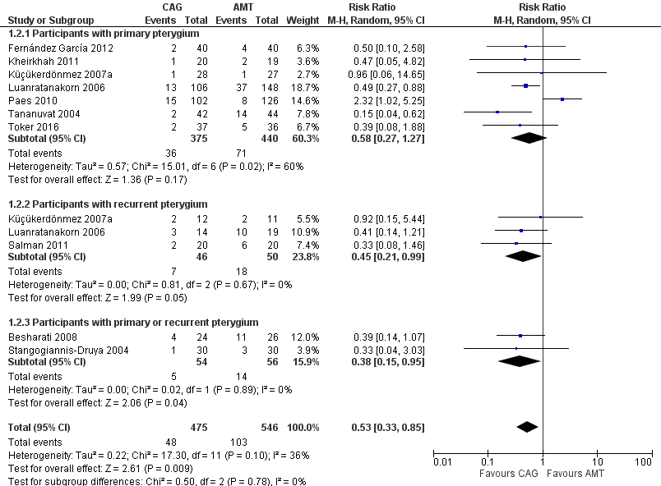
Recurrence of pterygium at 6 months

Slide 9
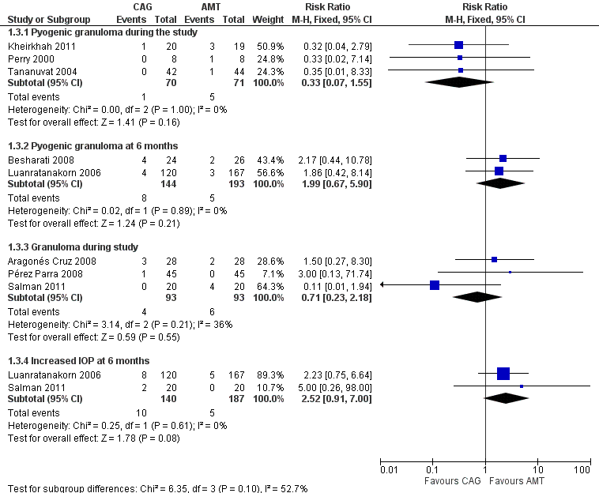
Adverse Events

Slide 10
05: Conclusions
“In association with pterygium excision, conjunctival autograft is associated with a lower risk of recurrence at six months' after surgery than amniotic membrane transplant.”

Slide 11


06: Acknowledgements
Cochrane Eyes and Vision US Satellite, funded by the National Eye Institute, National Institutes of Health
Cochrane Eyes and Vision Editorial Base, funded by the UK National Health Service Research and Development Programme
Elizabeth Clearfield, Valliammai Muthappan, Xue Wang, Irene C Kuo
Review citation
Clearfield E, Muthappan V, Wang X, Kuo IC. Conjunctival autograft for pterygium. Cochrane Database of Systematic Reviews 2016, Issue 2. Art. No.: CD011349. DOI: 10.1002/14651858.CD011349.pub2.

