Slide 1
Combined surgery versus cataract surgery alone for eyes with cataract and glaucoma
Mingjuan L Zhang, Phenpan Hirunyachote, Henry Jampel
Issue 7, 2015
A presentation to:
Meeting name
  Date

Slide 2
Table of Contents
01 | Background
02 | Types of studies
03 | Key results
04 | Tables (Risk of Bias/Forest Plots)
05 | Conclusions
06 | Acknowledgements

Slide 3
01: Background
Cataract and glaucoma are common comorbitidies in elderly people
Performing glaucoma and cataract surgery simultaneously may increase risk of complications
There are benefits to performing both surgeries together
Objective:
  To asses the effectiveness and safety of combined cataract and glaucoma surgery versus cataract surgery alone

Slide 4
02: Types of studies
  Participants
  Nine randomized controlled trials, 657 eyes of 655 participants
  Interventions
  Glaucoma + Cataract surgery VERSUS Cataract surgery alone
  Three studies used trabeculectomy
  Three studies used iStent ® implants
  One study used trabeculotomy
  Two studies used trabecular aspiration

Slide 5
03: Key results
“All of these studies found a statistically significant greater decrease in mean IOP postoperatively in the combined surgery group compared with cataract surgery alone”
MD -1.62 mmHg, 95% CI -2.61 to -0.64, 489 eyes
“…two studies found the mean number of medications used postoperatively at one year was about one less in the combined surgery group than the cataract surgery alone group.”
MD -0.69, 95% CI -1.28 to -0.01; 301 eyes

Slide 6
03: Key results (continued)
“Five studies showed that participants in the combined surgery group were about 50% less likely compared with the cataract surgery alone group to use one or more IOP-lowering medications one year postoperatively.”
RR 0.47, 95% CI 0.28 to 0.80; 453 eyes
“…six studies reported no significant differences in visual acuity and two studies reported no significant differences in visual fields between the two intervention groups postoperatively.”

Slide 7
03: Key results (continued)
“The effect of combined surgery versus cataract surgery alone on the need for reoperation to control IOP at one year was uncertain.”
RR 1.13, 95% CI 0.15 to 8.25; 382 eyes

Slide 8
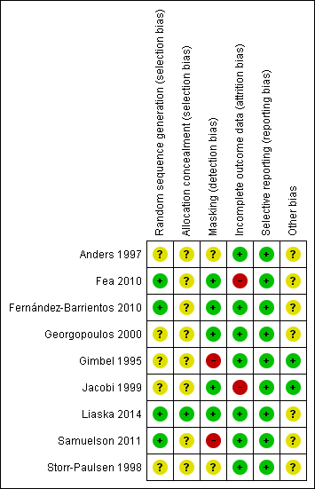
04: Tables

Slide 9
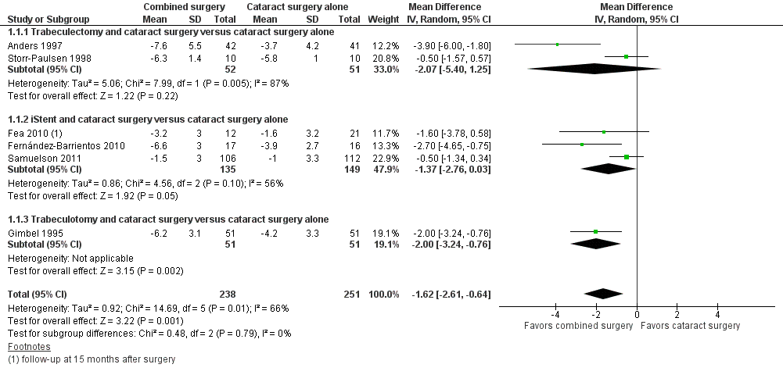
04: Tables
Mean change in IOP at one year

Slide 10
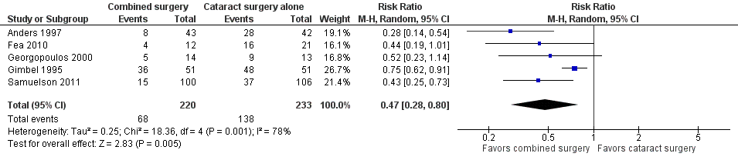
04: Tables
Proportion using 1+ medications at one year

Slide 11
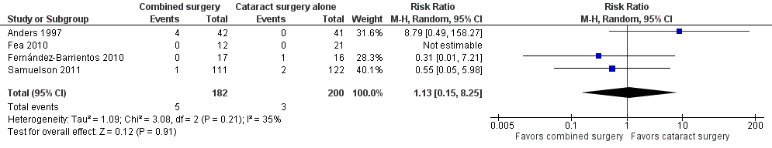
04: Tables
Proportion receiving reoperation to control IOP within one year following surgery

Slide 12
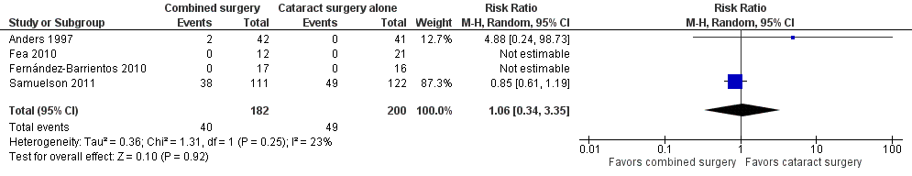
04: Tables
Proportion who received intervention for surgical complications within one year

Slide 13
05: Conclusions
“There is low quality evidence that combined cataract and glaucoma surgery may result in better IOP control at one year compared with cataract surgery alone.”
“…this Cochrane review has highlighted the lack of data regarding important measures of the patient experience, such as visual field tests, quality of life measurements, and economic outcomes after surgery, and long-term outcomes.”

Slide 14


06: Acknowledgements
Cochrane Eyes and Vision US Satellite, funded by the National Eye Institute, National Institutes of Health
Cochrane Eyes and Vision Editorial Base, funded by the UK National Health Service Research and Development Programme
Mingjuan L Zhang, Phenpan Hirunyachote, Henry Jampel
Review citation
Zhang ML, Hirunyachote P, Jampel H. Combined surgery versus cataract surgery alone for eyes with cataract and glaucoma. Cochrane Database of Systematic Reviews 2015, Issue 7. Art. No.: CD008671. DOI: 10.1002/14651858.CD008671.pub3

