Slide 1
Autologous serum eye drops for dry eye Qing Pan, Adla Angelina, Michael Marrone, Walter J Stark, Esen K Apek Issue 2, 2017
A presentation to:
Meeting name
Date

Slide 2
Table of Contents
01 | Background
02 | Types of studies
03 | Key results
04 | Tables (Risk of Bias/Forest Plots)
05 | Conclusions
06 | Acknowledgements

Slide 3
01: Background
Dry eye is a common disorder, often treated with artificial tears
Artificial tears lack biological nutrients found in natural tears
Autologous serum eye drops are made by separating liquid and cellular components of the patients blood
Question is:
Are autologous serum drops a safe and effective alternative to artificial tears?

Slide 4
02: Types of studies
Participants
Five randomized controlled trials (RCTs) with 92 participants (149 eyes) with dry eye caused by various conditions
Interventions
Autologous serum drops, alone or in conjunction with artificial tears
VERSUS
Artificial tears, saline, placebo, or no treatment

Slide 5
03: Key results
“…the mean OSDI score in the AS 20% group was lower than in the artificial tears group, although scores for both groups fell within the moderate OSDI category.”
Assessed at four weeks
“…the mean composite symptom score was 5.36 for the 20% AS group and 6.45 for the saline group. Trial investigators reported that mean symptom scores were not statistically significantly different.”

Slide 6
03: Key results (continued)
Mean differences in fluorescein and Rose Bengal staining before and after treatment were not clinically important and were still classified as abnormal.
Tear film break-up time also saw no clinically important differences between treatment groups.
Results from Schirmer’s test were also considered clinically unimportant.

Slide 7
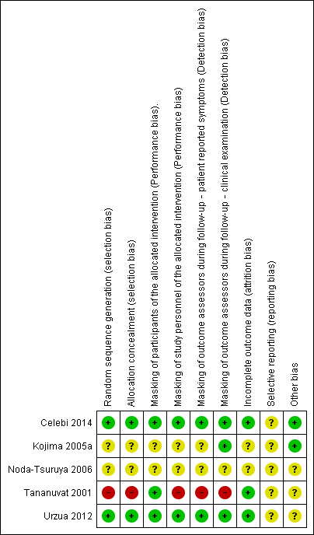
04: Tables

Slide 8
05: Conclusions
“The five trials comparing AS versus artificial tears or saline did not consistently observe improvement in participant-reported symptoms.”
“A major difficulty that review authors encountered in summarizing the results of included studies was heterogeneity among participant populations, interventions, and comparisons, as well as variation in procedures performed to prepare AS.”

Slide 9


06: Acknowledgements
Cochrane Eyes and Vision US Satellite, funded by the National Eye Institute, National Institutes of Health
Cochrane Eyes and Vision Editorial Base, funded by the UK National Health Service Research and Development Programme
Qing Pan, Adla Angelina, Michael Marrone, Walter J Stark, Esen K Akpek
Review citation
Pan Q, Angelina A, Marrone M, Stark WJ, Akpek EK. Autologous serum eye drops for dry eye. Cochrane Database of Systematic Reviews 2017, Issue 2. Art. No.: CD009327. DOI: 10.1002/14651858.CD009327.pub3

