Slide 1
Adjunctive steroid therapy versus antibiotics alone for acute endophthalmitis after intraocular procedure Carol H Kim, Monica F Chen, Anne L Coleman Issue 11, 2015
A presentation to:
Meeting name
Date

Slide 2
Table of Contents
01 | Background
02 | Types of studies
03 | Key results
04 | Tables (Risk of Bias/Forest Plots)
05 | Conclusions
06 | Acknowledgements

Slide 3
01: Background
Endophthalmitis is an infection inside the eye that can cause vision loss
Endophthalmitis is often a surgical complication; 90% of postoperative endophthalmitis occurs after cataract surgery
Treated with antibiotics; steroids as adjunctive therapy is controversial
Question:
What are the effects of treating endophthalmitis with antibiotics alone versus treating it with antibiotics and steroids?

Slide 4
02: Types of studies
Participants
Three randomized controlled trials (RCTs) with 95 participants with suspected bacterial endophthalmitis after cataract surgery
Interventions
Steroids (intravitreous dexamethasone) and antibiotics (intravitreous, any type)
VERSUS
Antibiotics alone (intravitreous, any type)

Slide 5
03: Key results
“Among the participants with postoperative endophthalmitis, 87.5% (14 out of 16) of those who received intravitreous dexamethasone and intravitreous antibiotics achieved anatomical and functional success compared with 81.5% (13 out of 16) of the intravitreous antibiotics-alone group”
Relative risk (RR) 1.08, 95% confidence interval (CI) 0.80 to 1.45; 32 eyes
“At three months, more participants who received intravitreous dexamethasone and antibiotics had a good visual outcome (6/6 to 6/18) compared with those in the antibiotics-alone group”
RR 1.95, 95% CI 1.05 to 3.60

Slide 6
03: Key results (continued)
“For participants in the postcataract group, there was no statistically significant difference in the mean number of Snellen lines of improvement at three months between those who received intravitreous dexamethasone and those who received placebo.”
“No outcomes related to IOP were reported by any included study.”

Slide 7
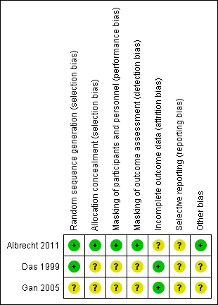
04: Tables

Slide 8
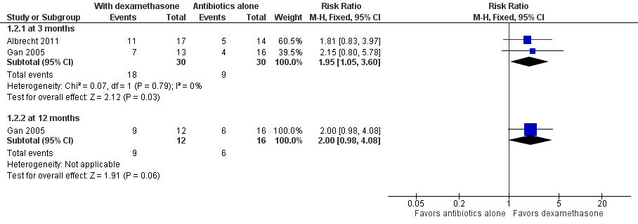
04: Tables Snellen visual acuity 6/6 to 6/18

Slide 9
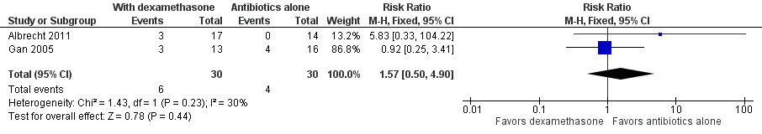
04: Tables Retinal Detachment

Slide 10
05: Conclusions
“Evidence for the effectiveness of using steroids in conjunction with intravitreous antibiotics for the treatment of acute endophthalmitis following intraocular procedure remains too meager to provide support”
“Most of the current evidence on this topic is inconsistent and has major limitations”
“This review highlights the limited amount of randomized controlled trial data available for assessing the effect of adjunctive steroids for postprocedure endophthalmitis treatment”

Slide 11


06: Acknowledgements
Cochrane Eyes and Vision US Satellite, funded by the National Eye Institute, National Institutes of Health
Cochrane Eyes and Vision Editorial Base, funded by the UK National Health Service Research and Development Programme
Carol H Kim, Monica F Chen, Anne L Coleman
Review citation
Kim CH, Chen MF, Coleman AL. Adjuctive seroid therapy versus antibiotics alone for acute endophthalmitis. Cochrane Database of Systematic Reviews 2017, Issue 2. Art. No.: CD004008. DOI: 10.1002/14651858.CD012131.pub2

